Slide 1
Community-Based Participatory Research:
Lessons for Stakeholder Engagement in Patient-Centered Outcomes Research
<?xml version="1.0"?><AllQuestions />
<?xml version="1.0"?><AllResponses />
<?xml version="1.0"?><Settings><answerBulletFormat>Numeric</answerBulletFormat><answerNowAutoInsert>No</answerNowAutoInsert><answerNowStyle>Explosion</answerNowStyle><answerNowText>Answer Now</answerNowText><chartColors>Use PowerPoint Color Scheme</chartColors><chartType>Horizontal</chartType><correctAnswerIndicator>Checkmark</correctAnswerIndicator><countdownAutoInsert>No</countdownAutoInsert><countdownSeconds>10</countdownSeconds><countdownSound>TicToc.wav</countdownSound><countdownStyle>Box</countdownStyle><gridAutoInsert>No</gridAutoInsert><gridFillStyle>Answered</gridFillStyle><gridFillColor>255,255,0</gridFillColor><gridOpacity>50%</gridOpacity><gridTextStyle>Keypad #</gridTextStyle><inputSource>Response Devices</inputSource><multipleResponseDivisor># of Responses</multipleResponseDivisor><participantsLeaderBoard>5</participantsLeaderBoard><percentageDecimalPlaces>0</percentageDecimalPlaces><responseCounterAutoInsert>No</responseCounterAutoInsert><responseCounterStyle>Oval</responseCounterStyle><responseCounterDisplayValue># of Votes Received</responseCounterDisplayValue><insertObjectUsingColor>Red</insertObjectUsingColor><showResults>Yes</showResults><teamColors>Use PowerPoint Color Scheme</teamColors><teamIdentificationType>None</teamIdentificationType><teamScoringType>Voting pads only</teamScoringType><teamScoringDecimalPlaces>1</teamScoringDecimalPlaces><teamIdentificationItem></teamIdentificationItem><teamsLeaderBoard>5</teamsLeaderBoard><teamName1></teamName1><teamName2></teamName2><teamName3></teamName3><teamName4></teamName4><teamName5></teamName5><teamName6></teamName6><teamName7></teamName7><teamName8></teamName8><teamName9></teamName9><teamName10></teamName10><showControlBar>All Slides</showControlBar><defaultCorrectPointValue>0</defaultCorrectPointValue><defaultIncorrectPointValue>0</defaultIncorrectPointValue><chartColor1>187,224,227</chartColor1><chartColor2>51,51,153</chartColor2><chartColor3>0,153,153</chartColor3><chartColor4>153,204,0</chartColor4><chartColor5>128,128,128</chartColor5><chartColor6>0,0,0</chartColor6><chartColor7>0,102,204</chartColor7><chartColor8>204,204,255</chartColor8><chartColor9>255,0,0</chartColor9><chartColor10>255,255,0</chartColor10><teamColor1>187,224,227</teamColor1><teamColor2>51,51,153</teamColor2><teamColor3>0,153,153</teamColor3><teamColor4>153,204,0</teamColor4><teamColor5>128,128,128</teamColor5><teamColor6>0,0,0</teamColor6><teamColor7>0,102,204</teamColor7><teamColor8>204,204,255</teamColor8><teamColor9>255,0,0</teamColor9><teamColor10>255,255,0</teamColor10><displayAnswerImagesDuringVote>Yes</displayAnswerImagesDuringVote><displayAnswerImagesWithResponses>Yes</displayAnswerImagesWithResponses><displayAnswerTextDuringVote>Yes</displayAnswerTextDuringVote><displayAnswerTextWithResponses>Yes</displayAnswerTextWithResponses><questionSlideID></questionSlideID><controlBarState>Expanded</controlBarState><isGridColorKnownColor>True</isGridColorKnownColor><gridColorName>Yellow</gridColorName></Settings>
<?xml version="1.0"?><AllAnswers />
June 19th, 2013

Slide 2

Welcome
Penny Mohr, MA
Senior Vice President, Program Development
Center for Medical Technology Policy

Slide 3
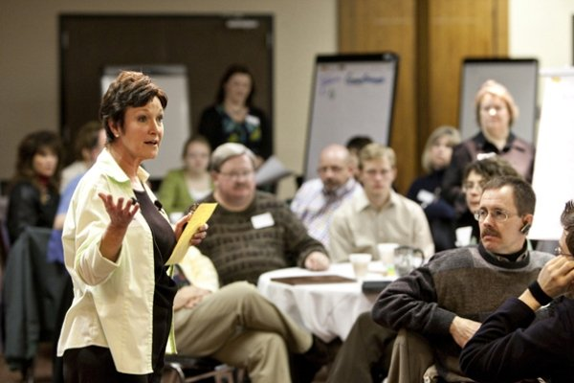
AHRQ Community Forum
To expand stakeholder involvement in comparative effectiveness research in AHRQ’s Effective Health Care Program
To advance methods for gathering public input on value-based healthcare questions
Learn More
http://www.effectivehealthcare.ahrq.gov/index.cfm/who-is-involved-in-the-effective-health-care-program1/ahrq-community-forum/
Notes:
Funded by the ARRA
By stakeholders we mean patients, clinicians, payers, policymakers

Slide 4
Today’s Goals
To bring together experts in the fields of CBPR and stakeholder engagement in PCOR
To discuss ways in which key lessons from CBPR can enhance stakeholder engagement methodology
To encourage greater dialogue and resource sharing between the CBPR and PCOR research communities going forward

Slide 5

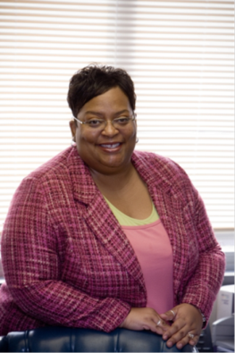

Webinar Speakers
Patricia Deverka, MD, MS, MBE
Senior Research Director
Center for Medical Technology Policy
Dwyan Monroe
Community Outreach Trainer/Patient representative
C. Daniel Mullins, PhD
Professor
Department of Pharmaceutical Health Services Research
University of Maryland School of Pharmacy

Slide 6


Webinar Speakers
Madeleine Shalowitz, MD, MBA
Research Associate (Associate Professor) of Pediatrics
University of Chicago, Pritzker School of Medicine
Director, Center for Clinical and Research Informatics
NorthShore Research Institute
Nina Wallerstein, DrPH, MPH
Professor, Public Health Program
University of New Mexico School of Medicine

Slide 7
Webinar Agenda
Introduction to CBPR and Stakeholder Engagement in PCOR
Nina Wallerstein, Madeleine Shalowitz, and Pat Deverka
Understanding the Similarities and Differences Between CBPR and Stakeholder Engagement in PCOR
Drawing on CBPR Lessons for PCOR
Engaging Underrepresented Populations
Daniel Mullins and Nina Wallerstein

Slide 8
General Discussion and
Questions from the Audience
We will respond to questions from the audience during the last 15 minutes of the webinar, but encourage the submission of questions throughout.
Please use the chat feature to type and submit your questions. The webinar facilitator will share your question with the audience, and ask the speakers to respond.
We will do our best to respond to everyone, but our time may be limited.
We will follow up on any questions we are unable to address after the webinar has concluded.

Slide 9
Community Based Participatory Research: Principles and Conceptual Framework
Nina Wallerstein, DrPH
Professor, Public Health Program
University of New Mexico

Slide 10
Community Based Participatory Research (CBPR) Definition
Collaborative approach to research that equitably involves all partners in the research process and recognizes the unique strengths that each brings. CBPR begins with a research topic of importance to the community with the aim of combining knowledge and action for social change to improve community health and eliminate health disparities.
(W.K. Kellogg Foundation)

Slide 11
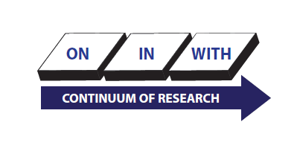
Continuum of Community Based Research:
N.M. CARES Health Disparities Center
University of New Mexico

Slide 12
CBPR Principles
Recognizes community as unit of identity
Cooperative and co-learning process
Systems development & local capacity building
Long term commitment
Balances research and action Israel et al, 1998 and 2008
CBPR Principles for Tribes
Tribal systems shall be respected and honored
Tribal government review and approval
Tribally specific data shall not be published without prior consultation; data belongs to tribe
Core Values: trust, respect, self-determination, mutuality of interests, perspective taking, reciprocity

Slide 13
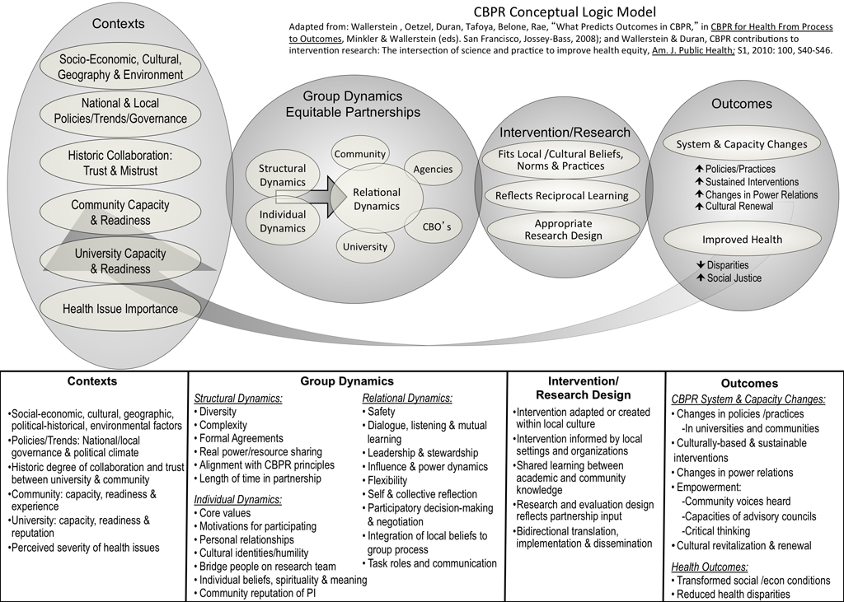

Slide 14
Research for Improved Health (RIH):
NIH Study of Community-Academic Partnerships
Aims: To advance science of CBPR to achieve equity
2009-2013
Test CBPR Conceptual Model hsc.unm.edu/SOM/fcm/cpr/cprmodel.shtml
Literature Review of measurement tools/metrics
  258 articles; 46 studies; 224 process/outcomes measures
Project code of ethics and integrity, protocols for students, publications, communication, tools: http://narch.ncaiprc.org
Develop New Instruments and Data Collection
Case Studies: 7 diverse communities
Internet Survey: 294 partnerships from 2009 RePORTER database
  http://iwri.org/health/resources/cbpr-resources/community/
  Key Informant (KI) Survey for PI/PD: Factual Data
  Community Engagement (CE) Survey: Perceived Perspectives of Partners

Slide 15
Examples: Community Engaged/
Key Informant Scales: Predictors
Context (10)
  Community Capacity, Project has what it needs to work effectively towards its aims
Alignment with CBPR Principles (8)
  Builds on resources and strengths, equitable partnerships, etc.
Core values (4)
  shared understanding of the missions and the strategies
Power dynamics (9)
  Power sharing, influence, decision making
Dialogue, Listening, co-learning
  Conflict resolution, emotional intelligence
Partner Research Roles (13)
  -- Community Engaged Research Index (CERI)
Trust Typology
  From Mistrust to Ideal Trust

Slide 16
Outcomes:
Partnership Synergy (5)
  Come together and work well
Culture Centeredness (5)
  Community theories, ownership, etc.
Personal, Political, Professional Level Outcomes (13)
  -- New knowledge, relationships, power, visibility, skills, etc.
Concrete & Perceived Outcomes (8)
-- Index of Perceived Community/Policy Level Outcomes (IPCPLO). Improved services, policy change, health improvement, etc.

Slide 17
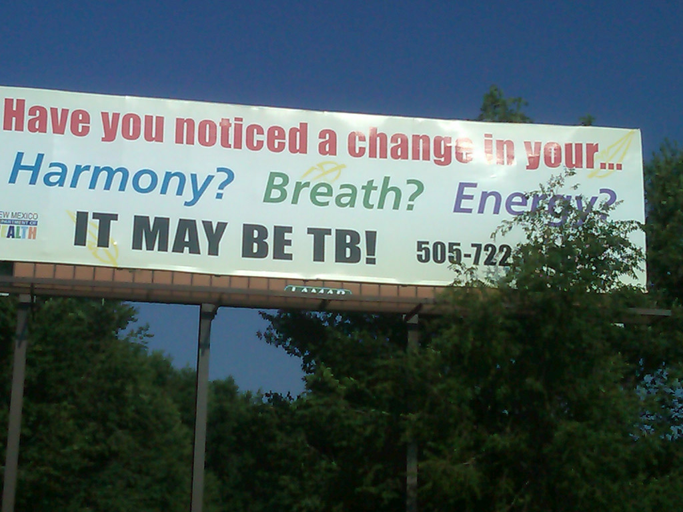

Slide 18
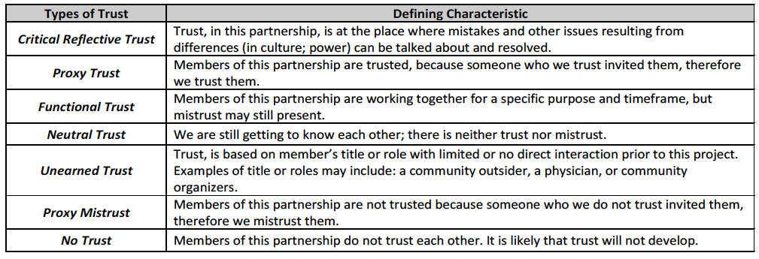
Metrics: Trust Indicators

Slide 19
CBPR Value System for Program Development, Evaluation and Information Sharing in a Health System Environment
Madeleine U. Shalowitz, MD, MBA
Research Associate (Associate Professor) of Pediatrics, University of Chicago, Pritzker School of Medicine
Director, Center for Clinical and Research Informatics
NorthShore University HealthSystem
MShalowitz@northshore.org

Slide 20
The Health System’s Perspective
Payor
Culture/
Society
Health System
Family
Patients
Health Outcome

Slide 21

The Patient’s Perspective
STRESS
SUPPORT
CULTURE
SOCIETY
COMMUNITY
FAMILY
Health system is here
RELATIONSHIP
CHILD
PARENT
Shalowitz, M. J Allergy and Clinical Immunology, 2008

Slide 22
Be Well Lake County
NorthShore University HealthSystem’s signature community benefit program since 2009
Comprehensive diabetes management for adult, medically underserved, Type 2 Diabetics in Lake County, IL
A partnership between NorthShore University HealthSystem and the Lake County Health Department

Slide 23
Program Development: Clinical
Health System Improvement in a CBPR Value System: Be Well Lake County
Collaborative development among NorthShore, community health department service providers, patient input and data in an iterative process over time
  Comprehensive primary care visits medication and testing supply assistance
  Subsidized subspecialty care access from NorthShore physicians
  Medical nutrition therapy and diabetes education
  Fitness programs
  Community garden
  Retinal screenings
Patient input

Slide 24
Be Well Research Innovation
Based on provider and patient input, we added a food security measure and learned that almost 57% of the patients with type 2 diabetes in Lake County did not have adequate food
STUDY QUESTION
Do patients who don’t have enough food have worse diabetes control?

Slide 25
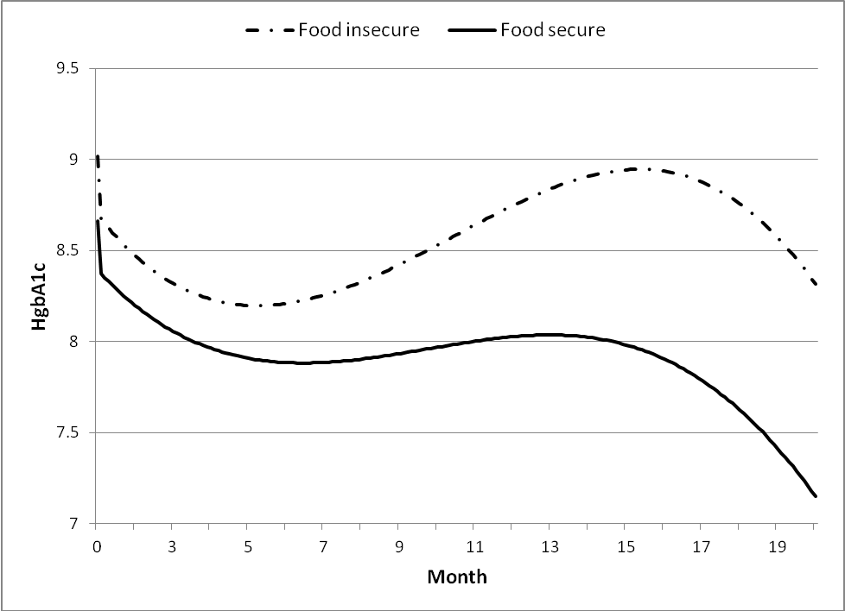
Initial Results: Growth Curve Estimated HgbA1c By Food Insecurity Status (n=255)
p<.05
Not having enough food interferes with glucose control despite comprehensive diabetes care. Interference with glucose control increases over time
Shalowitz etal. APHA 2010

Slide 26
CBPR Organizational Structure
(NICHD Community Child Health Network- Lake County)
Academic Steering Committee
Community Advisory Committee
Northwestern University
NorthShore
Community Health Center
Lake County Communities
Sample PCOR Adaptation
Payor/Provider Steering Committee
Community Advisory Committee
Payor
Health System
Patients
Family and Communities

Slide 27
Patient-Centered Outcomes Research and Stakeholder engagement
Patricia Deverka | June 19th, 2013

Slide 28
Definitions of cer and pcor
Definition of CER
Definition of PCOR
The generation and synthesis of evidence that compares the benefits and harms of alternative methods to prevent, diagnose, treat, and monitor a clinical condition or to improve the delivery of care. The purpose of CER is to assist consumers, clinicians, purchasers, and policy makers to make informed decisions that will improve health care at both the individual and population levels.
Source: Institute of Medicine
Patient-Centered Outcomes Research (PCOR) helps people and their caregivers communicate and make informed health care decisions, allowing their voices to be heard in assessing the value of health care options.
PCOR has the following characteristics:
• Actively engages patients and key stakeholders throughout the research process.
• Compares important clinical management options.
• Evaluates the outcomes that are most important to patients.
• Addresses implementation of the research findings in clinical care environments.
Source: PCORI

Slide 29
Barriers to involving stakeholders in cer
Confusing terminology
Lack of shared understanding of what it means to “successfully” involve stakeholders in research
Limited data regarding impact; systematic evaluation rare
Timing; restrictions on availability of stakeholders
Training needs for all stakeholders to maximize participation
Concerns that process will add time and costs to project plans
Sources: Guise, O'Haire, McPheeters, et al. A practice-based tool for engaging stakeholders in future research: a synthesis of current practices. J Clin Epidemiol. 2013 Jun;66(6):666-74. doi: 10.1016/j.jclinepi.2012.12.010. Epub 2013 Mar 13. and CMTP experience

Slide 30
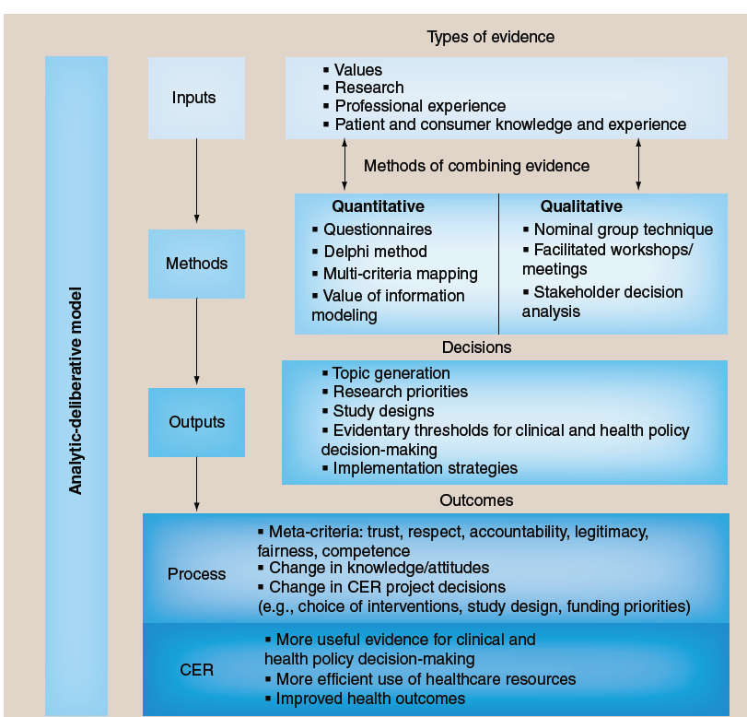
Conceptual model for stakeholder engagement in comparative effectiveness research
Source: Deverka, Lavallee, Desai et al., JCER 2012; 1(2): 181-94
Stakeholder: Individuals, organizations or communities that have a direct interest in the process and outcomes of a project, policy or research endeavor – including patients and consumers, healthcare providers, payers and purchasers, policy-makers and regulators, industry representatives, researchers and research funders.
Stakeholder engagement: An iterative process of actively soliciting knowledge, experience, judgment and values of individuals selected to represent a broad range of direct interests in a particular issue for the dual purposes of 1.) creating a shared understanding and 2.) making relevant, transparent and effective decisions.

Slide 31
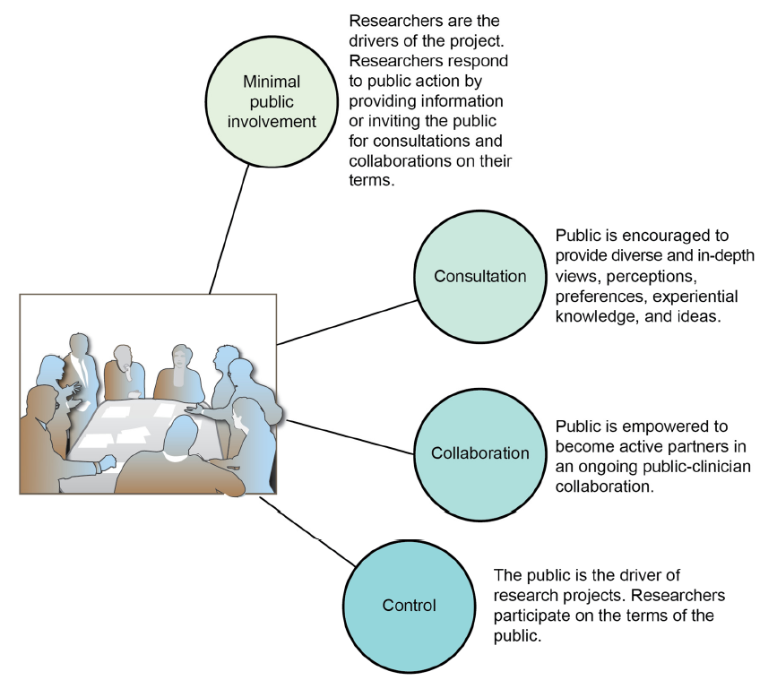
Typology of stakeholder engagement
Stakeholder engagement “light”
Stakeholder engagement
Source: Nass, Levine, and Yancy. Methods for Involving Patients in Topic Generation for Patient-Centered Comparative Effectiveness Research –An International Perspective

Slide 32
Similarities and Differences Between
CBPR and PCOR
<?xml version="1.0"?><AllQuestions />
<?xml version="1.0"?><AllResponses />
<?xml version="1.0"?><Settings><answerBulletFormat>Numeric</answerBulletFormat><answerNowAutoInsert>No</answerNowAutoInsert><answerNowStyle>Explosion</answerNowStyle><answerNowText>Answer Now</answerNowText><chartColors>Use PowerPoint Color Scheme</chartColors><chartType>Horizontal</chartType><correctAnswerIndicator>Checkmark</correctAnswerIndicator><countdownAutoInsert>No</countdownAutoInsert><countdownSeconds>10</countdownSeconds><countdownSound>TicToc.wav</countdownSound><countdownStyle>Box</countdownStyle><gridAutoInsert>No</gridAutoInsert><gridFillStyle>Answered</gridFillStyle><gridFillColor>255,255,0</gridFillColor><gridOpacity>50%</gridOpacity><gridTextStyle>Keypad #</gridTextStyle><inputSource>Response Devices</inputSource><multipleResponseDivisor># of Responses</multipleResponseDivisor><participantsLeaderBoard>5</participantsLeaderBoard><percentageDecimalPlaces>0</percentageDecimalPlaces><responseCounterAutoInsert>No</responseCounterAutoInsert><responseCounterStyle>Oval</responseCounterStyle><responseCounterDisplayValue># of Votes Received</responseCounterDisplayValue><insertObjectUsingColor>Red</insertObjectUsingColor><showResults>Yes</showResults><teamColors>Use PowerPoint Color Scheme</teamColors><teamIdentificationType>None</teamIdentificationType><teamScoringType>Voting pads only</teamScoringType><teamScoringDecimalPlaces>1</teamScoringDecimalPlaces><teamIdentificationItem></teamIdentificationItem><teamsLeaderBoard>5</teamsLeaderBoard><teamName1></teamName1><teamName2></teamName2><teamName3></teamName3><teamName4></teamName4><teamName5></teamName5><teamName6></teamName6><teamName7></teamName7><teamName8></teamName8><teamName9></teamName9><teamName10></teamName10><showControlBar>All Slides</showControlBar><defaultCorrectPointValue>0</defaultCorrectPointValue><defaultIncorrectPointValue>0</defaultIncorrectPointValue><chartColor1>187,224,227</chartColor1><chartColor2>51,51,153</chartColor2><chartColor3>0,153,153</chartColor3><chartColor4>153,204,0</chartColor4><chartColor5>128,128,128</chartColor5><chartColor6>0,0,0</chartColor6><chartColor7>0,102,204</chartColor7><chartColor8>204,204,255</chartColor8><chartColor9>255,0,0</chartColor9><chartColor10>255,255,0</chartColor10><teamColor1>187,224,227</teamColor1><teamColor2>51,51,153</teamColor2><teamColor3>0,153,153</teamColor3><teamColor4>153,204,0</teamColor4><teamColor5>128,128,128</teamColor5><teamColor6>0,0,0</teamColor6><teamColor7>0,102,204</teamColor7><teamColor8>204,204,255</teamColor8><teamColor9>255,0,0</teamColor9><teamColor10>255,255,0</teamColor10><displayAnswerImagesDuringVote>Yes</displayAnswerImagesDuringVote><displayAnswerImagesWithResponses>Yes</displayAnswerImagesWithResponses><displayAnswerTextDuringVote>Yes</displayAnswerTextDuringVote><displayAnswerTextWithResponses>Yes</displayAnswerTextWithResponses><questionSlideID></questionSlideID><controlBarState>Expanded</controlBarState><isGridColorKnownColor>True</isGridColorKnownColor><gridColorName>Yellow</gridColorName></Settings>
<?xml version="1.0"?><AllAnswers />
Madeleine Shalowitz and Pat Deverka

Slide 33
Discussion Questions
What are the similarities and differences between
CBPR and PCOR?

Slide 34
CBPR and PCOR:
How much do they have in Common?
CBPR
Goal:
Combine knowledge and action for social change; focus on topics of importance to community
Intervention/Research Design:
Reflects commitment to true partnership with community
Outcomes:
*Transform social and economic conditions
*Reduce health disparities
*System and capacity changes
PCOR
Goal:
Help people and their caregivers communicate and make informed health care decisions, allowing their voices to be heard in assessing the value of health care options.
Intervention/Research Design:
Reflects predominately consultation, trying to move to collaboration
Outcomes:
*More useful evidence for clinical and health policy decision-making
*Shift the research agenda (system and capacity changes)
Improved
health outcomes
Participation of individuals outside the traditional scientific paradigm
Characterized by mutual respect and trust

Slide 35
Reaction from the patient perspective
Dwyan Monroe
Community Outreach Trainer/
Patient Representative

Slide 36
Discussion Questions
Are there enough similarities to allow us to draw lessons
from CBPR about how to better engage stakeholders
in PCOR?

Slide 37
Discussion Questions
What are the strategies for effectively equalizing the
power structure between researchers and other
stakeholders that allow for shared decision making?

Slide 38
Discussion Questions
Given the differences in the time frame between
PCOR and CBPR, what lessons can we draw about
how to sustain engagement over the long term?

Slide 39
Discussion Questions
What are the strategies for measuring the impact
of stakeholder engagement on project and patient
outcomes?

Slide 40
Discussion Questions
What are some successful dissemination strategies
for bringing the results back to the community?

Slide 41
Engaging underrepresented populations
<?xml version="1.0"?><AllQuestions />
<?xml version="1.0"?><AllResponses />
<?xml version="1.0"?><Settings><answerBulletFormat>Numeric</answerBulletFormat><answerNowAutoInsert>No</answerNowAutoInsert><answerNowStyle>Explosion</answerNowStyle><answerNowText>Answer Now</answerNowText><chartColors>Use PowerPoint Color Scheme</chartColors><chartType>Horizontal</chartType><correctAnswerIndicator>Checkmark</correctAnswerIndicator><countdownAutoInsert>No</countdownAutoInsert><countdownSeconds>10</countdownSeconds><countdownSound>TicToc.wav</countdownSound><countdownStyle>Box</countdownStyle><gridAutoInsert>No</gridAutoInsert><gridFillStyle>Answered</gridFillStyle><gridFillColor>255,255,0</gridFillColor><gridOpacity>50%</gridOpacity><gridTextStyle>Keypad #</gridTextStyle><inputSource>Response Devices</inputSource><multipleResponseDivisor># of Responses</multipleResponseDivisor><participantsLeaderBoard>5</participantsLeaderBoard><percentageDecimalPlaces>0</percentageDecimalPlaces><responseCounterAutoInsert>No</responseCounterAutoInsert><responseCounterStyle>Oval</responseCounterStyle><responseCounterDisplayValue># of Votes Received</responseCounterDisplayValue><insertObjectUsingColor>Red</insertObjectUsingColor><showResults>Yes</showResults><teamColors>Use PowerPoint Color Scheme</teamColors><teamIdentificationType>None</teamIdentificationType><teamScoringType>Voting pads only</teamScoringType><teamScoringDecimalPlaces>1</teamScoringDecimalPlaces><teamIdentificationItem></teamIdentificationItem><teamsLeaderBoard>5</teamsLeaderBoard><teamName1></teamName1><teamName2></teamName2><teamName3></teamName3><teamName4></teamName4><teamName5></teamName5><teamName6></teamName6><teamName7></teamName7><teamName8></teamName8><teamName9></teamName9><teamName10></teamName10><showControlBar>All Slides</showControlBar><defaultCorrectPointValue>0</defaultCorrectPointValue><defaultIncorrectPointValue>0</defaultIncorrectPointValue><chartColor1>187,224,227</chartColor1><chartColor2>51,51,153</chartColor2><chartColor3>0,153,153</chartColor3><chartColor4>153,204,0</chartColor4><chartColor5>128,128,128</chartColor5><chartColor6>0,0,0</chartColor6><chartColor7>0,102,204</chartColor7><chartColor8>204,204,255</chartColor8><chartColor9>255,0,0</chartColor9><chartColor10>255,255,0</chartColor10><teamColor1>187,224,227</teamColor1><teamColor2>51,51,153</teamColor2><teamColor3>0,153,153</teamColor3><teamColor4>153,204,0</teamColor4><teamColor5>128,128,128</teamColor5><teamColor6>0,0,0</teamColor6><teamColor7>0,102,204</teamColor7><teamColor8>204,204,255</teamColor8><teamColor9>255,0,0</teamColor9><teamColor10>255,255,0</teamColor10><displayAnswerImagesDuringVote>Yes</displayAnswerImagesDuringVote><displayAnswerImagesWithResponses>Yes</displayAnswerImagesWithResponses><displayAnswerTextDuringVote>Yes</displayAnswerTextDuringVote><displayAnswerTextWithResponses>Yes</displayAnswerTextWithResponses><questionSlideID></questionSlideID><controlBarState>Expanded</controlBarState><isGridColorKnownColor>True</isGridColorKnownColor><gridColorName>Yellow</gridColorName></Settings>
<?xml version="1.0"?><AllAnswers />
C. Daniel Mullins and Nina Wallerstein

Slide 42
Reaction from the patient perspective
Dwyan Monroe
Community Outreach Trainer/
Patient Representative

Slide 43
Discussion Questions
What are some essential lessons about engaging
underrepresented populations in CBPR that would
be applicable to PCOR?

Slide 44
General Discussion and
Questions from the Audience
Please remember to use the chat feature to type and submit your questions. The webinar facilitator will share your question with the audience, and ask the speakers to respond.
We will follow up on any questions we are unable to address after the webinar has concluded.

Slide 45
Thank You for Participating!

