Slide 1
The Evidence-Based Care (EBC) Challenge for NPs and PAs:
Using Evidence in the Retail Clinic Setting
Welcome!
Reminder: You will need a phone to take part in this discussion.
Click “Audio” at the top of this WebEx screen and then click “Teleconference.”
Enter the phone number where you’d like to be called in the second box and click “Call Me.”
You will be called within two minutes after entering the phone number.
When you answer, select Option 1 to join the audio portion of the session.
Or, you can join the teleconference by calling in on your own.
Click on the small arrow in the top box and select “I will call in” from the drop down menu.
This will list the toll free number and access code for you to call and join the teleconference.
For technical support: Contact Jess Fernandez at jfernandez@air.org

Slide 2
The Evidence-Based Care (EBC) Challenge for NPs and PAs:
Using Evidence in the Retail Clinic Setting

Slide 3
Today’s Agenda
Welcome and Reminders
Community Forum Overview
The EBC Challenge
Remarks from Winning Teams
Advisory Committee Commentary
Audience Q&A
Adjourn

Slide 4
Technology Reminders: Audio
Reminder: You will need a phone to take part in this discussion.
Click “Audio” at the top of this WebEx screen and then click “Teleconference.”
Enter the phone number where you’d like to be called in the second box and click “Call Me.”
You will be called within two minutes after entering the phone number.
When you answer, select Option 1 to join the audio portion of the session.
Or, you can join the teleconference by calling in on your own.
Click on the small arrow in the top box and select “I will call in” from the drop down menu.
This will list the toll free number and access code for you to call and join the teleconference.

Slide 5
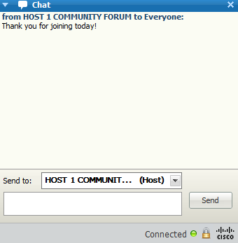
Technology Reminders: Submitting questions for Q&A session and technical assistance
During the presentation, please feel free to send in your questions using the chat box located on the right side of your screen (see right).
We will be collecting and providing questions to our moderator for the Q&A session of the webinar.
Note: You will have the option to send your questions as a private chat message to the “HOST 1 COMMUNITY FORUM (Host)” or a public message to “Everyone” which all participants will be able to see (select these options from the drop-down menu).
For technical support: If you are having any technical difficulties during the webinar, contact Jess Fernandez at jfernandez@air.org or send a private chat message to “HOST 1 COMMUNITY FORUM (Host)”

Slide 6
AHRQ Community Forum

Slide 7
Community Forum
Help the Effective Health Care Program to identify more systematic and effective approaches for obtaining public views
Ensure consistent and comprehensive stakeholder involvement in all aspects of AHRQ’s expanded EHC Program
Collaborative partnership:
    American Institutes for Research ◊ Center for Medical Technology Policy ◊ Consumers Union ◊ AcademyHealth

Slide 8
What is the Effective Health Care Program?
Part of the research portfolio of the Agency for Healthcare Research and Quality (AHRQ), HHS
Houses AHRQ’s program of Comparative Effectiveness Research (CER)
Purpose: To help patients, consumer, providers, and policy-makers make informed choices among alternatives. Provides current, unbiased evidence on comparative effectiveness of health care interventions
Includes a variety of research: systematic reviews; observational studies; trials; analysis of registry data

Slide 9
Effective Health Care Program Products
Free research summaries about the benefits and risks of different treatments for different health conditions, based on comparative effectiveness reviews. (Reports, rather than clinical recommendations or guidelines)
Consumer, clinician, and policymaker guides

Slide 10










AHRQ EHC Program Nursing Workgroup
Who’s Involved
  A group of 10 national professional nursing organizations dedicated to working with AHRQ to advance the needs of the nursing community, improving patient care, and increasing awareness of CER
Purpose
  Foster open dialogue between nursing organizations and AHRQ to discuss ways the EHC Program and the nursing community can work together to improve care.
  Provide insights and feedback on how to engage nurses in CER.

Slide 11
AHRQ EHC Program Nursing Workgroup
What they do
  Preview EHC Program initiatives and provide feedback on how to reach and engage nurses
  Educate members and patients on CER and the EHC Program
  Share new research, CE opportunities, patient education, and resources and tools with members
Contact: Cheryl.Thompson@ahrq.hhs.gov

Slide 12
The EBC Challenge
Objectives:
  Goal: Increase engagement of Nurse Practitioners (NPs) and Physician Assistants (PAs) in EHC program
  Translate existing AHRQ research reports into provider-friendly resources for use in retail settings-
    Health Literacy Interventions and Outcomes: An Updated Systematic Review, and
    either Acute Otitis Media, Update or the Screening for Obesity in Children and Adolescents
Who:
  Nurse practitioners (NPs), physician assistants (PAs), researchers, students, and other health professionals
Notes:
Edits consistent with idea that NPs and PAs aren’t a “new” stakeholder group for AHRQ

Slide 13
Purpose of the EBC Challenge
Encourage development of relevant and useful resources that can be adapted for use by NPs and PAs in the convenience care setting
Introduce and expand use of evidence from the EHC Program to an important clinician audience
Increase awareness of the EHC Program and its products among the retail NP and PA communities
Learn about effective ways to communicate with the retail NP and PA communities
Notes:
ADAPTED rather than adopted

Slide 14
EBC Challenge Timeline
Launch
June 18
Intent to Submit
Aug. 17
Judging
Late Nov.
Dissemin-ation
Early 2013
Close
Oct. 19
Marketing/Promotion
14

Slide 15
Judging Process
All entries were reviewed by a panel of expert judges composed of:
  Academics
  Practitioners
  Patients
  Representatives from convenience care organizations and the retail clinic industry
15

Slide 16
Criteria
Submissions were scored on a 100 point scale:
  Effectiveness (i.e., is the resource tailored to highlight and effectively communicate key content areas most relevant to NPs/PAs in retail settings?) – 40 points
  Usefulness at point of care (i.e., can the resource be easily used by NPs and PAs at the point of care in the retail setting?) – 30 points
  Scalability (i.e., can the resource be used by a larger target audience?) – 15 points
  Creativity (i.e., is the resource intuitive and “catchy?”) – 10 points
  Team composition (i.e., does the team represent a variety of disciplines?) Please note that each team must include at least one NP or PA with experience practicing in a retail setting, but should not exceed 10 members – 5 points
16

Slide 17
Prizes!
1st place: $7,500 "seed funding" award to implement resource in a retail setting
2nd place: $1,000 support for designated team members to attend a relevant professional conference
3rd place: Two members receive a one-year subscription to UpToDate, an evidence-based, peer reviewed information resource to inform point of care decisions
All winners have been featured in blog posts, listservs, social media, AHRQ and AcademyHealth websites, and trade publications
17

Slide 18
Team Remarks
First Place: QR Medica
Second Place: PAWS Team
Third Place: The Tympanic Trio
View winning submissions:
http://effectivehealthcare.ahrq.gov/index.cfm/tools-and-resources/the-ahrq-evidence-based-care-ebc-challenge/

Slide 19
QR Medica Team
Kelly McGee, M.B.A., M.S.N., N.P.-C
Melinda McGaughy, M.S.N., F.N.P.-BC,
Paul Vineyard, Freelance IT

Slide 20
The QR Medica Team
Kelly McGee - MBA, MSN, DNPc, NP-C
Melinda McGaughy - BSN, MS, FNP-BC
Janet Schmittgen - BS, RPh, Walgreens Pharmacist
Jordan A. McGaughy - Nursing Student, Central Ohio Technical College
Amanda McGaughy - Nursing Student, The Ohio State University
Christine Lake – ADN, American Institute of Alternative Medicine
Paul Vineyard - Marketing, Design, Training , Business Development
Notes:
Presenter – Paul
Presentation Controller: Paul Vineyard

Slide 21
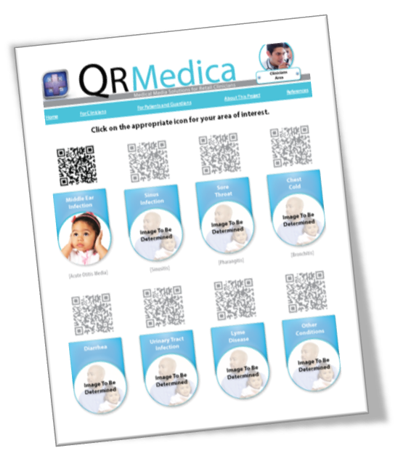
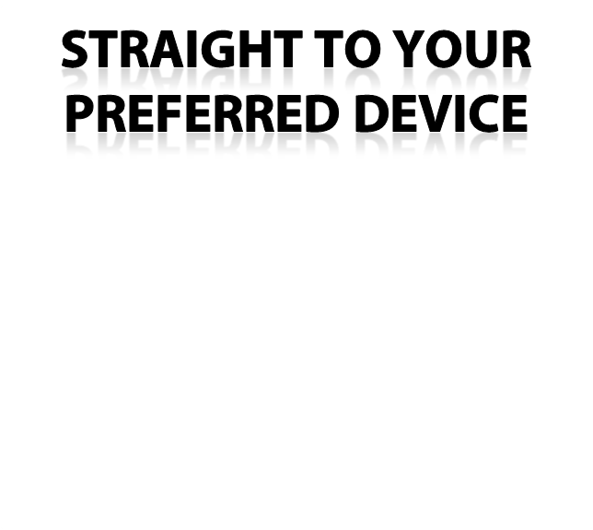


Imagine Evidence Based Care …
Diagnosis, Treatment & Patient Education Information at Your Fingertips
Notes:
Presenter – Paul
Presentation Controller: Paul Vineyard

Slide 22

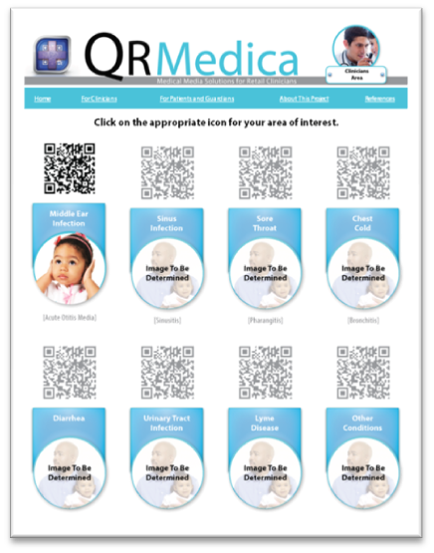

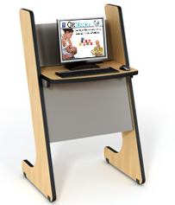
Connecting Patient and Provider
Office Posters
Handouts
Clinic Kiosks
LCD Video Monitors
Web Access
Notes:
Presenter – Paul
Presentation Controller: Paul Vineyard

Slide 23
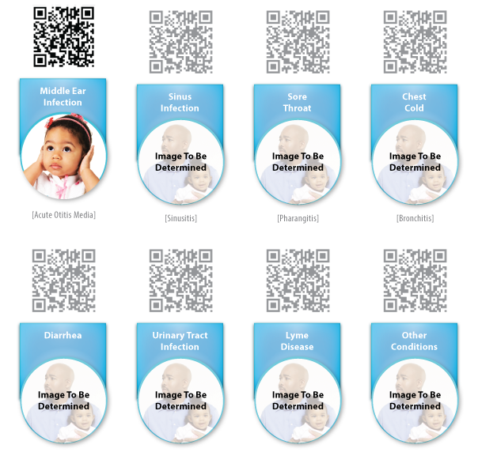
Common Retail Clinic Conditions
Sinus Infections
Sore Throats
Chest Colds
Diarrhea
Urinary Tract Infections
Lyme Disease
Other Conditions
Notes:
Presenter – Melinda
Presentation Controller: Paul Vineyard

Slide 24
Resourcing the Medical Community
Posters in clinics/pharmacies
Article in Drug Store News
Booth at the Convenient Care Association Retail Clinicians Education Congress
Poster Presentation at the American Academy of Nurse Practitioners (AANP) National Convention June 2014
Ohio Association of Advance Practice Nurses (OAAPN) poster presentation
Develop application (App Store ITunes)
YouTube video
Partnering with ENT associations, pediatric associations and family practice associations
Notes:
Presenter: Kelly McGee
Presentation Controller: Paul Vineyard

Slide 25
Working with the EBC Challenge
Why Acute Otitis Media?
The Need for Dissemination in Retail Clinics
Providing “Real-World” Solutions
Affirming Best Practices
Consistency in the Marketplace
Notes:
Presenter: Kelly McGee
Presentation Controller: Paul Vineyard

Slide 26
The Secret of Our Success
Diversity of Knowledge and Skills
Convenient Care Business Management
Real-World Experience
Marketing, Design, and Advertising Perspectives
Robust Technology Experience
Unique Collective Perspective
Notes:
Presenter: Kelly McGee
Presentation Controller: Paul Vineyard

Slide 27
Working with AHRQ and AcademyHealth
Insightful Perspective
Helpful Suggestions
Quality Assurance
Industry Standard Compliance
Experts in Evidence Based Research
Insightful Comments and Suggestions
Ensuring Compliance
Notes:
Presenter: Kelly McGee
Presentation Controller: Paul Vineyard

Slide 28
PAWS Team: Prescription for Antibiotics or Wait and See
Janette Capaci, A.R.N.P.

Slide 29
PAWS Resource
A double-sided brochure on otitis media intended to help patients navigate treatment decisions with their provider at the point of care.
Utilizes animal paw prints and acronyms
Encourages the patient to follow a path to good health
Supports evidence-based guidelines
Notes:
Presenter and Controller: Janette Capaci

Slide 30
Why a brochure?
Easily reproducible
Accessible and reliable tool at point of care
Reinforces evidence based treatment plan
Illustrated resource for patients
User-friendly
Resource tool for provider and pharmacy
Applies to all patients regardless of access to electronics and computers
Notes:
Presenter and Controller: Janette Capaci

Slide 31
Enhances Care Delivery
Applicable to children and adults
Resource tool
Promotes active interaction of patient in decision making tree
Reinforcement of information after the clinic visit
Collaborative care model of use of resource by provider, pharmacy, students and patients
Notes:
Presenter and Controller: Janette Capaci

Slide 32
Plan for Dissemination
Submission of abstract for presentation at Retail Clinician Educational Conference
Submission for abstract for local University Research Day
Submission as a Doctoral Capstone Project
Educational sessions for local retail health clinicians for utilization of brochure
Long term goal to expand use among retail health agencies nation wide
Notes:
Presenter and Controller: Janette Capaci

Slide 33
PAWS Team
CVS/MinuteClinic- One Store One Team approach
Team composition
  Nurse Practitioner
  Pharmacist
  Store Manger
  Shift Supervisors
  Photo Lab Supervisor
Notes:
Presenter and Controller: Janette Capaci

Slide 34
Team Challenges
Accessible to all members of the team
Applicable to all members of the team
Unified goal
Diverse educational and professional back rounds and knowledge base
Highlighting common goals among all members
Complexity of project
Time frame
Notes:
Presenter and Controller: Janette Capaci

Slide 35
Nurse Practitioner Role
The changes of the delivery of health care systems in a retail clinic setting requires the advanced practice nurse to demonstrate high clinical proficiency, leadership skills, and apply evidence based practice to improve outcomes (Draye, Ackerman, & Zimmer, 2006).
Notes:
Presenter and Controller: Janette Capaci

Slide 36
Nurse Practitioners
Inter-professional collaboration,
Cost quality outcomes,
Health care delivery systems in a retail health setting
Health care leadership
Evidence based medication
Notes:
Presenter and Controller: Janette Capaci

Slide 37
The Tympanic Trio
Nicola Archie B.S.N., M.S.N., F.N.P.-C
Tara Jones B.S.N., M.S.N., F.N.P.-C

Slide 38
Content
Flipbook:
  Provider views one side of the booklet and the patient views the other side of the booklet. Terminology and education differ based on the side that is being viewed.
  Interactive teaching tool
  User-friendly
  Easily accessible
Notes:
Speaker Nicola Archie

Slide 39
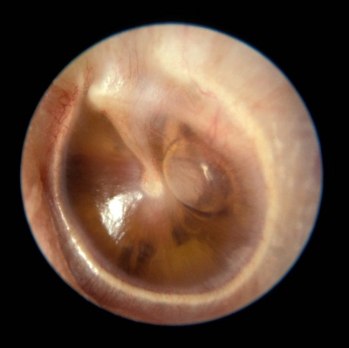
Flipbook Example
Provider View
Patient View
Otitis Media with Effusion
Treatment can vary based on child’s age and severity of symptoms. Uncomplicated AOM, the existing research suggests the “Wait and see” approach (9).
Patient/Guardian Instructions
Keep ears clean and dry
Follow up with your provider for symptoms of fever, ear pain, drainage from the ear
Follow up with provider as directed
Fluid in the Ear Drum
With this type of an ear infection, clear fluid builds up or collects behind the ear drum (9). Often the fluid will go away on its own without medication (9).
“Wait and see” approach (9).
Patient/Guardian Instructions
Keep ears clean and dry
Follow up with your provider for symptoms of fever, ear pain, drainage from the ear
Follow up with provider as directed
Notes:
Speaker Nicola Archie

Slide 40
Enrich provider-patient interactions
Quick reference guide
Easy to read and maneuver
Provides visual illustrations
Can transport the resource to any setting
Notes:
Speaker Nicola Archie

Slide 41
Dissemination of the resource
Short-term:
  Retail Clinician Educational Conference 2013
Long-term:
  Introduce the resource to other clinical settings (Doctors’ offices, urgent care centers)
Notes:
Speaker Nicola Archie

Slide 42
Expansion of the resource
Transform flipbook from paperback to hard cover
Partner with a vendor to create a digitally enhance application (cell phones, iPads)
Create an interactive online tool
Notes:
Speaker Nicola Archie

Slide 43
Implementation into retail settings
Use flipbook to educate about:
  Upper respiratory infection (common cold)
  Pharyngitis (sore throat)
  Conjunctivitis (eye infection)
  Dermatological conditions (rashes)
Notes:
Speaker Nicola Archie---Last slide pass the ball to Tara Jones

Slide 44
Appeal of the Challenge
Healthcare provider challenge
Developing a useful resource
Improve health literacy
Educate patients and healthcare providers
Notes:
Speaker Tara Jones

Slide 45
Challenges working as a team
Lack of graphic design artist
Difficult to obtain photos for booklet
Time management-- to meet desired goals/deadlines
Putting all of the pieces of the project together
Notes:
Speaker Tara Jones

Slide 46
AHRQ Report
Evidence-based
Descriptive
Comprehensive
Educational
Notes:
Speaker Tara Jones

Slide 47
Integrating evidence into practice
Fosters continuing education
Provides factual standards/measures
Aids in technological advancements
Framework for medical growth through research
Notes:
Last Slide/ conclusion----Speaker Tara Jones

Slide 48
Advisory Committee Commentary
Dr. Mary Jo Goolsby, Vice President, Research, Education, & Professional Practice, AANP

Slide 49
Audience Q&A

Slide 50
Submitting questions for Q&A session
Please feel free to send in your questions using the chat box located on the right side of your screen (see right).
We will be collecting and providing questions to our moderator for the Q&A session of the webinar.
Note: You will have the option to send your questions as a private chat message to the “HOST 1 COMMUNITY FORUM (Host)” or a public message to “Everyone” which all participants will be able to see (select these options from the drop-down menu).

Slide 51
Wrap Up
View winning submissions and learn more about the EBC Challenge:
  http://effectivehealthcare.ahrq.gov/index.cfm/tools-and-resources/the-ahrq-evidence-based-care-ebc-challenge/ or
  http://challenge.gov/HHS/427-evidence-based-care-challenge-applying-evidence-in-np-pa-retail-settings
EBC Challenge case study – coming soon!
For questions or follow up, please contact Joanna Siegel at Joanna.Siegel@ahrq.hhs.gov

Slide 52
Thank you!

