Slide 1
Agency for Healthcare Research and Quality
Community Forum
June 13, 2013
Using Deliberative Methods
to Engage the Public:
Facilitating a Deliberative Session
Notes:
Welcome, everyone, to this webinar about using deliberative methods to engage the public: facilitating a deliberative session.

Slide 2
Purpose and objectives
Purpose:
  Provide practical guidance on facilitating deliberative sessions
  Explore how these facilitation skills can be used in your work
At the end of the session you should be able to:
  Identify facilitation skills unique to deliberation
  Develop exercises for guiding group discussion
  Understand how to use facilitation tools to prepare for your groups
Notes:
First, we want to go over the purpose of today’s session. As you know, deliberation is a method of public consultation that is designed to obtain informed input on a complicated question. The techniques for facilitating a deliberative session differ in important ways from facilitating a focus group or meeting to garner top of mind responses.
In this webinar, our goal is to describe how to facilitate a deliberative session - and provide you with facilitation techniques, exercises, and tools that can help you facilitate a deliberative process.
At the end of this session, you should be able to:
Identify facilitation skills unique to deliberation
Develop exercises for guiding group discussion
Understand how to use facilitation tools to prepare for your groups

Slide 3



Presenter introductions
Dierdre Gilmore, MA, Senior Researcher,
American Institutes for Research (AIR)
Marge Ginsburg, MPH, Director, Center for Healthcare Decisions
Ela Pathak-Sen, Director, Commotion
Notes:
I am Dierdre Gilmore, Senior Researcher at the American Institutes for Research. Thank you all for joining. We’re really excited that you are participating. We have a number of people on the line, coming from government organizations, universities, community organizations, foundations, and medical associations, among others.
I want to introduce my co-presenters: Marge Ginsburg and Ela Pathak-Sen. I also want to recognize Jess Fernandez, our research associate, who has helped us tremendously in our preparation.
Also, Joanna Siegel, our Project Officer at AHRQ, is on the line and has contributed a great deal to this presentation.

Slide 4
Community Forum description
Agency for Healthcare Research and Quality’s initiative called Community Forum
Led by the American Institutes for Research (AIR) with key partners
Major part of this project is to:
    Advance the use of deliberative methods for obtaining input from members of the public on a health research topic
Notes:
This webinar is part of a three-year project, funded by the Agency for Healthcare Research and Quality (AHRQ) and led by the American Institutes for Research (AIR).
Initiated in August 2010, this project includes two key parts:
To expand stakeholder engagement in AHRQ’s Effective Health Care Program,
To advance understanding about the use of public deliberation as a method of public consultation
In the second part of the project we conducted a large demonstration project using deliberative methods to examine public views on the use of evidence in health decisions, a topic central to the Agency’s work in patient centered outcomes research. This demonstration included 76 public deliberations using four different deliberative methods across the country from August to November last year. This webinar focuses on what we have learned about how to facilitate a deliberative session, which we are excited to be sharing with you today.

Slide 5
Today’s agenda
Welcome
What is a deliberative process and what is a deliberative question?
Facilitation techniques
Managing the discussion
Group exercises
Managing participant behavior
Facilitation tools
Facilitator training
Q&A
Notes:
Today’s agenda will focus on: what is a deliberative process and a deliberative question, facilitation techniques, managing the discussion, group exercises, managing participant behavior, facilitation tools and facilitator training.
We are also going to try to make this webinar a bit interactive.
We will be using the chat box feature on the right side of the WebEx screen and encourage you to send in your questions and comments throughout the session. We are saving about a half hour of time for question and answer after the presentation and hope to address a number of these questions or comments at that time.
We will be opening the line for a couple of deliberative exercises. We will be muting and unmuting the lines for the exercises so you’ll hear us working through this in real-time. Most importantly, we’d love to include some of you in a short, 3 minute exercise and are looking for 2 volunteers. If you are willing to participate, please send us a message to the “Host (Cailin Falato)” in the chat box on the right.
I’d now like to turn it over to Marge who will begin our discussion on describing a deliberative process.

Slide 6
What is a deliberative process?
  Asks the public to be a problem-solver
    Problem is policy-oriented, complex, multi-faceted
    Requires accurate, unbiased facts
    Has multiple solutions, each with trade-offs
    Requires interactive discussion/debate
    Decisions grounded in personal/societal values
Notes:
Before describing the role of the facilitator for public deliberation, it’s important to fully grasp what a deliberative process is and what makes it different from other types of public input. Once it is clear what deliberation is intended to do, then the strategies the facilitator uses makes much more sense.
First and foremost, deliberation asks people to be problem-solvers. (review the characteristics on the ppt)
Deliberation is often confused with focus groups because they can appear the same – a group of 10-12 people sitting around a table with a facilitator. But what they are doing around the table is what distinguishes them. Let me give you an example of the same topic that is asked in a focus group and is asked in a deliberative session. Since we are coming at this from the world of health care or health policy, that is the context we use here.
(next slide)

Slide 7
The overuse of antibiotics: focus group
  Question: How can doctors better communicate with patients about the risk?
  What researchers will learn:
    Views about personal right to decide
    What doctors need to say to patients
    What information might be useful to convey to the public about the risk of overusing antibiotics
Notes:
In conducting a focus group, the background information might be something like this:
Antibiotics are overused in this country, leading to bacteria that cannot be controlled. Research shows that patients often insist on getting a prescription even if their doctor doesn’t think they need one. But it is very difficult saying ‘no’ to patients who are convinced they need one. How do you feel about this? How can doctors better communicate with patients?
What researchers will learn is how the public views their own authority in making these treatment decisions; what the doctor needs to say and do to reassure patients that they are not being short-changed; and the educational approach or information that will gain patients’ cooperation in not overusing antibiotics. All of this is opinion-giving and it is all valuable.
(next slide)

Slide 8
The overuse of antibiotics: deliberative session
  Question: should there be more specific limits on how doctors use antibiotics?
  What researchers will learn:
    Concerns about loss of patient/doctor authority
    How people balance the tension between personal choice and societal protection
    If there are acceptable strategies for maintaining clinical autonomy while reducing harm to others
Notes:
However, in conducting a deliberative session, the scenario would be different, something like this:
Regardless of considerable publicity about the dangers of overuse of antibiotics, they are still being prescribed excessively (and unnecessarily) and increasingly superbugs are killing patients. Should there be more specific limits on how doctors use antibiotics?
Rather than getting people’s reactions to messages (as in the focus group), this same scenario is now asking people to solve a problem: whether and how to restrict the authority of doctors and patients as a means of reducing the incidence of super-bugs.
Addressing the problem requires trade-offs that speak to social value judgments, e.g.:
Concerns about loss of patient/doctor authority
How people balance the importance of personal choice and concerns about societal protection
If there are acceptable strategies for maintaining clinical autonomy while reducing harm to others.
As in this example, delib topics take on societal issues, where the benefit of the group may differ from that of the individual. What is clearer now is that the common good may be a threat to individual freedom – or vice versa.
(next slide)

Slide 9
Be consistent with features of the session
  Facilitator takes into account…
    Complexity of the topic
    The time allocated for the process
    The number of participants
    Maintain principles of facilitation
      Neutrality
      Active talking by participants
      Dialogue among participants
Notes:
Our next presenter will be discussing many of the characteristics of participants as they progress through the deliberation and techniques the facilitator to can use to help participants maximize the outcome in terms of addressing the overarching question or problem being addressed.
Before I turn this over to Ela, I want to alert you to the fact that there are features of the deliberative design that will have great influence on what the facilitator does.
The first is complexity of the topic. This may determine how much time needs to be devoted to educating participants, use of outside experts and how many different techniques may need to be used to give participants sufficient exposure to the nuances of the issue. The more complex the topic, the more the facilitator may need to verify participants’ understand and be especially alert to statements that might indicate that some people are confused by the facts.
The second is the time allocated for deliberation. Deliberative methods span from a 2-hr. session to a 3-day session. The facilitator’s work may look very different depending on how much time is available to achieve the goal. The last is number of participants which also will influence which strategies are used to give participants the opportunities for deliberation. With large groups, break out sessions are often used.
Regardless of these attributes of the session, there are certain principles that the facilitator maintains no matter how large or how long the process is. These principles are:
Maintaining strict neutrality
Maximizing the opportunity for participants to talk
Encouraging dialogue among participants.
I’ll now turn it over to Ela to go into detail on participant characteristics and facilitator strategies.

Slide 10
Continuum of engagement
Passive P
Consultation
Functional P
Interactive P
Self-mobilization
What’s the question?
Who is participating?
What happens with the outcomes?
POWER
How much time have you got?
Notes:
In this section – I would like you to consider using this steps model as a way to think about facilitating to encourage deliberation. The beauty of using ‘steps’ is: you can climb up and down, you can jump, take two at a time……It is the context that helps you decide how you want to go. The essence is that : form follows function and it is important to think through the Who, What, When and Where.
In the next slides I will provide some pointers and tips on what to look out for, do at each of these stages. When we think of deliberation we are aiming for the group to be at the top of the steps. The key notion that drives this is POWER. When groups are deliberating effectively they basically have power vested in the group not in the facilitator.

Slide 11
Some facilitator tips to using this model
Key behaviors at each level include:
  Passive participation : Information giving so that participants understand processes
  Consultation participation: obtain and consider opinions, tell participants how their views will be heard
  Functional participation: the participants work to help the sponsor achieve project goals and consultation occurs after major decisions have been made
  Interactive participation: Participation is seen as a ‘right.’ Participants feel they have a stake in the issues, they provide multiple perspectives, they are in learning mode
  Self-mobilization participation: Participants control the process, they decide the agenda and resources
Passive P
Consultation
Functional P
Interactive P
Self-mobilization
Notes:
Using the Obesity example: one of the case studies we used related to the problem of the growing rate of Obesity and ways to tackle the problem
Passive P
The Participants need to do 2 things: one they need to understand what the problem is as described by the sponsor; two they need to know about the facilitation process to tackle this problem. Typical comments and questions at this point are: Say that again (asking for a repeat of facts and figures)
Consultation
Participants need to express their opinions, prejudices, likes and dislikes. They need to do this safely. Typical comments at this stage: I don’t think that’s the case, its their own fault, we should not be interfering, the cost is too high.
Functional
The participants hear about the’ new soda tax’ or program to eradicate ‘food deserts’ or whether resources should be spent of surgery or public health programmes – they are asked about how best to take these ideas forward.
Interactive: Participants begin to see how the problem of obesity affects them and society at large, they begin to challenge each other’s views and can provide reasons for the statements they make. They challenge expert views and opinions
Self-mobilization:
Participants are at the point where they have digested information, views and opinions and are able to put forward the issues as they see important. These may not be on the Agenda They begin to talk the language of values moving from an individual to societal perspective. Example: Actually its not about one intervention or another, its not about who deserves what – its about a problem that needs fixing and if we don’t do this together we are stuck!

Slide 12
Implementing the continuum
Build trust
  Icebreakers & energizers
  Ground rules
Give information
Passive P
Consultation
Functional P
Interactive P
Self-mobilization

Slide 13
Implementing the continuum
Organize the flow of discussion
  Active listening
  Stacking
  Signposting
Passive P
Consultation
Functional P
Interactive P
Self-mobilization

Slide 14
Implementing the continuum
Broaden participation
  EMU (encourage, moderate, use the clock)
  Use the ‘Hats’ exercise
Passive P
Consultation
Functional P
Interactive P
Self-mobilization

Slide 15
Implementing the continuum
Help folks make their point
  Active listening, draw folks out
  Give permission to disagree
Passive P
Consultation
Functional P
Interactive P
Self-mobilization

Slide 16
Implementing the continuum
Manage divergent perspectives
  Sequence
  Mind map
  Re-focus
Passive P
Consultation
Functional P
Interactive P
Self-mobilization

Slide 17
Self-mobilization
Move to self management
  Open Space
Passive P
Consultation
Functional P
Interactive P
Self-mobilization

Slide 18

Why, why, why, why –BUT WHY?

Slide 19
5 Whys
Borrowed from LEAN Six Sigma theory as a way of problem solving – getting to the root cause
Prepare participants for this – it can come across as rude
Onion theory – but gets to values and core judgments
Let’s try it…..

Slide 20
Trying out the 5 Whys
We need 3 participants plus the facilitator
The facilitator and one other participant agrees to be the ‘questioner”
The two participants who are in the role of ‘responder’ may choose one statement each from the list below
The first round is between the Facilitator and one of the participants
The second round is between the remaining two participants
Each round lasts 3 minutes max!

Slide 21
Choose one of the following statements or use one of your own
Our school system has failed young people.
With rights come responsibilities.
There is no such thing as a free lunch!
Charity begins at home.

Slide 22
Managing participant behavior
Establish ground rules
Think about how to respond to….
  Those that dominate
  Lengthy and off-topic monologues
  Snarky comments to others
    Don’t forget: you are in charge
Notes:
In any groups where individuals are dealing with sensitive issues that may challenge their thinking about what the ‘right’ thing to do is, participants can sometimes respond in ways that are not conducive to deliberation: they dominate the discussion; they get off-topic with long stories; they get antagonistic or sarcastic with those they don’t agree with.
Setting some ground rules at the beginning is helpful, if only because the facilitator can then remind people when needed without looking as if she is dreaming these up to fit the circumstances. The most common problem in sessions that have limited time are those participants who monopolize the conversation…either talking too often, too long or not germane to the topic.
There are a number of ways that the facilitator can redirect the discussion, e.g.:
Mary, I know this issue is important to you. Since we have limited time today, could you tell us how this incident affected the way you see this problem?
George, it’s really important that we hear from everyone, so I’m going to ask you to hold that thought and let’s hear now from those who haven’t had a chance to talk.
Frank, please remember that one of the ground rules we mentioned earlier is respect for others’ opinions. Let’s keep that in mind.
Although a goal of deliberative processes is for the participants to be discussing/debating with each other (not with the facilitator), the facilitator should never lose sight of the fact that she has control of the meeting.
I’m going to now turn this over to Dierdre who will talk about the process for training facilitators.

Slide 23
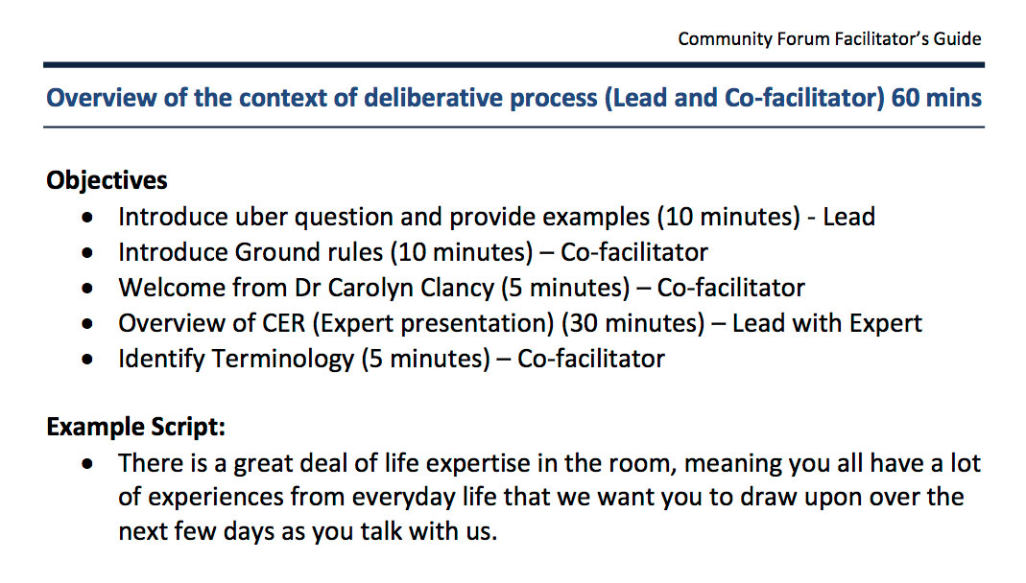
Facilitation tools: Facilitator Guide
Structured Facilitator Guide
  Activity, objective, time, lead, example script
Notes:
A facilitator’s guide can range from a brief outline to a full script. Your approach will depend on the deliberative method, facilitator experience, and goals of the session. No matter how detailed or not - the guide is intended as a blueprint for facilitators as they navigate participants through the issue at hand.
A structured guide is an invaluable tool and can include:
step-by-step activities, timing and staff responsibilities, so that each member of the facilitation team knows who will be presenting, how much time they have and the objective of the particular activity.
scripted language for each section from the purpose and goals of the session, how to introduce a case study, a list of potential questions to ask the participants, to introducing key experts. It’s important to note that this is example script, which may be modified by the facilitator.

Slide 24
Facilitation tools: Facilitator Guide
Structured Facilitator Guide
    Helps facilitators anticipate how the session will look and feel
    Serves as a training manual
    Remains flexible
Notes:
This structured approach helps facilitators anticipate how the session will look and feel, as well as what might happen in terms of where the conversation may go. It also gives them a training manual to practice from prior to the groups starting.
Once facilitators begin to utilize the guide in a deliberative group – the guide becomes a dynamic - more organic tool. The group you are facilitating will choose a discussion path that you may not have anticipated. Depending on the group and the discussion the facilitator will need to be flexible, changing the guide as needed.
Example of changes we made included how we presented the materials, adding in more local references and concrete examples, and refining questions to get at the deeper tensions within an issue.

Slide 25
Facilitation tools: Ice breakers
Ice breakers
  Stage 1: Getting to know you
  Stage 2: Understanding the process
  Stage 3: Creating a community
Notes:
Another tool a facilitator should have is an array of ice breakers.
There are three stages of ice breakers (I would like to walk you through) that can be utilized in a deliberation:
Stage 1: Getting to know you
Stage 2: Understanding the process and
Stage 3: Creating a community

Slide 26
Facilitation tools: Ice breakers
Ice breakers
  Stage 1: Getting to know you
Comic Strip
Panel 1 Panel 2
Comic Strip
Panel 3 Panel 4
Notes:
During stage 1: at the beginning of the session, a great way to build a sense of comfort quickly is through a “getting to know you’ ice breaker.
A good example of this is: is handing out half of a four panel comic strip (as you can see on the slide) to each person in the room. You can then ask them to stand up and find the other half of the comic strip that someone else is holding. Once participants have found their other half and are paired with a partner they in turn can ask each other’s name, why they came, and one fun fact. Each person can then introduce their partner to the group.
This activity allows you to create movement in the beginning of the day, pair people up who may not necessarily talk to one another, and to build a sense of comfort in in the room.

Slide 27
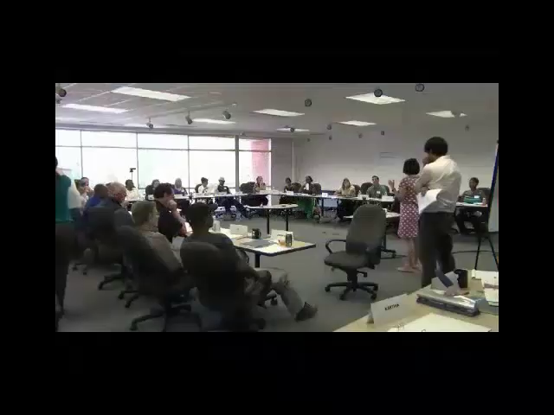
Facilitation tools: Ice breakers
Ice breakers
  Stage 2: Understanding the process
Notes:
During stage 2: early on in the session, you want to familiarize participants with deliberative process. Most likely some will be familiar with the process - while for others it will be new. A nice way to illustrate deliberation - and to make people feel comfortable (having and) discussing their stance on an issue - is to do it in an ice breaker. I want to play a clip for you from one of our groups that shows how this can be accomplished.
(This is a short 3 minute video. the sound will be played through your computer speakers. Please make sure to turn on your computer speakers to hear the audio, but for those of you having any trouble, the presentation will include subtitles. Unfortunately, if you are using a mobile device or tablet, the video may or may not be compatible with your software, but please stay on the line and we will resume right after the video)
As you see through this clip by creating something quite fun (and educational), people are beginning to feel comfortable sharing their opinion and hearing others.

Slide 28
Facilitation tools: Ice breakers
Ice breakers
  Stage 3: Creating a community
Notes:
Now in stage 3: around the mid-point of your session a sense of community is beginning to form. People are feeling comfortable with one another and they are almost ready to tackle the hard questions ahead. A great activity at this time is to hold a musical orchestra.
You can ask everyone to group themselves into an orchestra – choosing various instruments to ‘play a tune’ together (a song that is familiar such as ‘old McDonald’) using their voices as the instruments. This usually helps to break down any remaining barriers.
As you can see from these three examples, the key to any ice breaker is that it must be fun! When participants are having fun their defenses come down and that is when deliberation can truly begin.

Slide 29
Training: Practicing your skills
Become familiar with the material
Conduct an informal group
Hold a mock session
Get feedback
Visualize the room
Continue practicing!

Slide 30
Thank you!

