Slide 1
AHRQ Evidence-based Practice Center (EPC) Program
Welcome and thank you for joining the EPC Grand Rounds

Slide 2
Logistics
This meeting will be recorded and shared externally. Please use the chat and hand-raising functionality.

Slide 3
Facilitators
Lisa Simpson, M.B., B.Ch., M.P.H., FAAP
President and Chief Executive Officer – AcademyHealth
Lucy Savitz, Ph.D., M.B.A.
Professor – University of Pittsburgh Department of Health Policy and Management, Graduate School of Public Health Senior Innovation Advisor – University of Pittsburgh Medical Center for High-Value Health Care

Slide 4
Continuing Medical Education Credit
This activity has been planned and implemented in accordance with the accreditation requirements and policies of the Accreditation Council for Continuing Medical Education (ACCME) through the joint providership of OHSU School of Medicine and the Agency for Healthcare Research & Quality (AHRQ). OHSU School of Medicine designates this live activity for a maximum of 2.0 AMA PRA Category 1 Credits™. Physicians should claim only the credit commensurate with the extent of their participation in the activity.
Presenters
Name | Disclosure | Role/ Received
Dale Steele, MD, MS David Niebuhr, MD, MS, MPH | Nothing to disclose Nothing to disclose
Ian Saldanha, MBBS, MPH, PhD | Nothing to disclose
Jill Huppert, MD, MPH | Nothing to disclose
Disclosure Information
In accordance with the requirements of the Standards for Commercial Support of the ACCME, each instructor and member of the planning committee has been asked to disclose any relevant financial relationships with commercial interests that produce health care goods or services. The information disclosed for this activity is listed to the left.
In addition, the planners and instructors listed have agreed that all recommendations involving clinical medicine will be based on evidence that is generally accepted within the profession as adequate justification for their indications and contraindications in the care of patients; that all scientific research used in support or justification of a patient care recommendation will conform to the generally accepted standards of experimental design, data collection and analysis; and that material to be presented will be made available for advance peer review if requested.
Planning Committee
Name | Disclosure | Role/ Received
Craig Umscheid, MD, MPH | Nothing to disclose
Christine Chang, MD, MPH | Nothing to disclose
Lisa Simpson, MB, BCh, MPH, FAAP | Nothing to disclose
Lucy Savitz, PhD, MBA | Nothing to disclose
Mark Helfand, MD, MPH | Nothing to disclose
Celia Fiordalisi, MS | Nothing to disclose

Slide 5
Learning Objectives
Participants will be able to:
1. Discuss the role of healthcare providers, community organizations, and other stakeholders in improving postpartum care delivery and outcomes.
2. Analyze the impact of cultural, socioeconomic, and other factors on postpartum care and develop strategies to address these disparities.
3. Discuss the role of interdisciplinary care and collaboration in postpartum hypertension management, including the role of patients and their families in self-monitoring and self-management of hypertension.

Slide 6
Agenda
12:00–12:05 | Welcome and Review of Program | Lisa Simpson, M.B., B.Ch., M.P.H., FAAP
12:05–12:10 | Introduce EPC Report Authors and PCORI Engagement | Jennie Dalton, M.P.H.
12:10–12:15 | Introduce Discussants | Lucy Savitz, Ph.D., M.B.A.
12:15–12:30 | Report Presentation: Postpartum Care up to 1 Year After Pregnancy: A Systematic Review and Meta-analysis | Ian Saldanha, M.B.B.S., M.P.H., Ph.D. Jill Huppert, M.D., M.P.H.
12:30–12:35 | Initial Reactions | Rose Molina, M.D., M.P.H. Megan McReynolds, PMP
12:35–12:50 | Report Presentation: Management of Postpartum Hypertensive Disorders of Pregnancy | Dale Steele, M.D., M.S. David Niebuhr, M.D., M.S., M.P.H.
12:50–12:55 | Initial Reactions | Rose Molina, M.D., M.P.H. Megan McReynolds, PMP
12:55–1:10 | General Moderated Discussion and Q&A | Lucy Savitz, Ph.D., M.B.A.
1:10–1:55 | Thematic Focus: Policy, Equity, and Health Systems | Rose Molina, M.D., M.P.H. Megan McReynolds, PMP
1:55–2:00 | Closing Remarks | Lucy Savitz, Ph.D., M.B.A.

Slide 7
Introduction to Maternal Health Systematic Reviews
Patient-Centered Outcomes Research Institute
Jennie R. Dalton, M.P.H.
Program Officer
PCORI.org
Notes:
Next slide

Slide 8
About PCORI
An independent research institute authorized by Congress in 2010, reauthorized in 2019, and governed by a 23-member Board of Governors representing the entire healthcare community
Funds comparative effectiveness research (CER) that engages patients and other stakeholders throughout the research process
Seeks answers to real-world questions about what works best for patients based on their circumstances and concerns

Slide 9
PCORI’s Broad and Complex Mandate
“The purpose of the Institute is to assist patients, clinicians, purchasers, and policy-makers in making informed health decisions by advancing the quality and relevance of evidence concerning the manner in which diseases, disorders, and other health conditions can effectively and appropriately be prevented, diagnosed, treated, monitored, and managed through research and evidence synthesis...
… and the dissemination of research findings with respect to the relative health outcomes, clinical effectiveness, and appropriateness of the medical treatments, services...”
—from PCORI’s authorizing legislation

Slide 10
PCORI's Approach to Improving Maternal Health
EVIDENCE SYNTHESIS
Input from
Research Partners:
Patients
Caregivers
Providers
Payers
Government
Inform End Users
COMPARATIVE
EFFECTIVENESS
RESEARCH AWARDS
ENGAGEMENT
AWARDS

Slide 11
Collaborative Partnership: PCORI and AHRQ

Slide 12
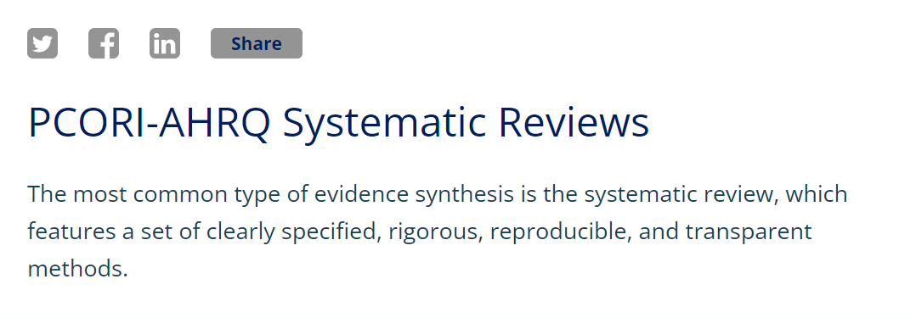
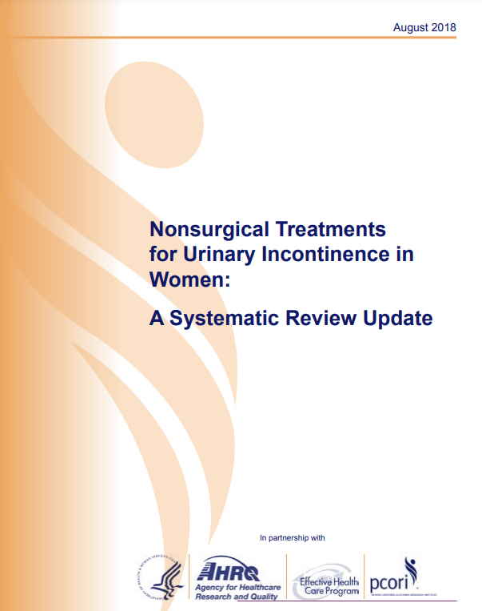
PCORI-Funded AHRQ Systematic Reviews
Evidence Synthesis
PCORI commissions systematic reviews from AHRQ’s Evidence-based Practice Center Program
Ten reviews completed
www.pcori.org/research-results/evidence-synthesis

Slide 13
Eight Ongoing Reviews

Slide 14
Engaging Research Partners to Identify Important Topics
Clinician
Caregiver/ Family Member of Patient
Patient/ Caregiver Advocacy Org
Hospital/ Health System
Purchaser
Payer
Industry
Policymaker
Training Institution
Patient/ Consumer
Research Partners

Slide 15
Medical Societies Identify Topics for Systematic Review
Collaborated with The American College of Obstetricians and Gynecologists (ACOG) for the reviews presented today

Slide 16
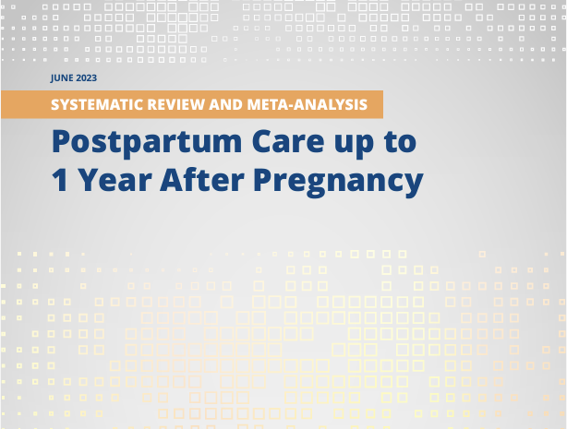
Ian Saldanha, M.B.B.S., M.P.H., Ph.D.
Task Order Officer: Jill Huppert, M.D., M.P.H.

Slide 17
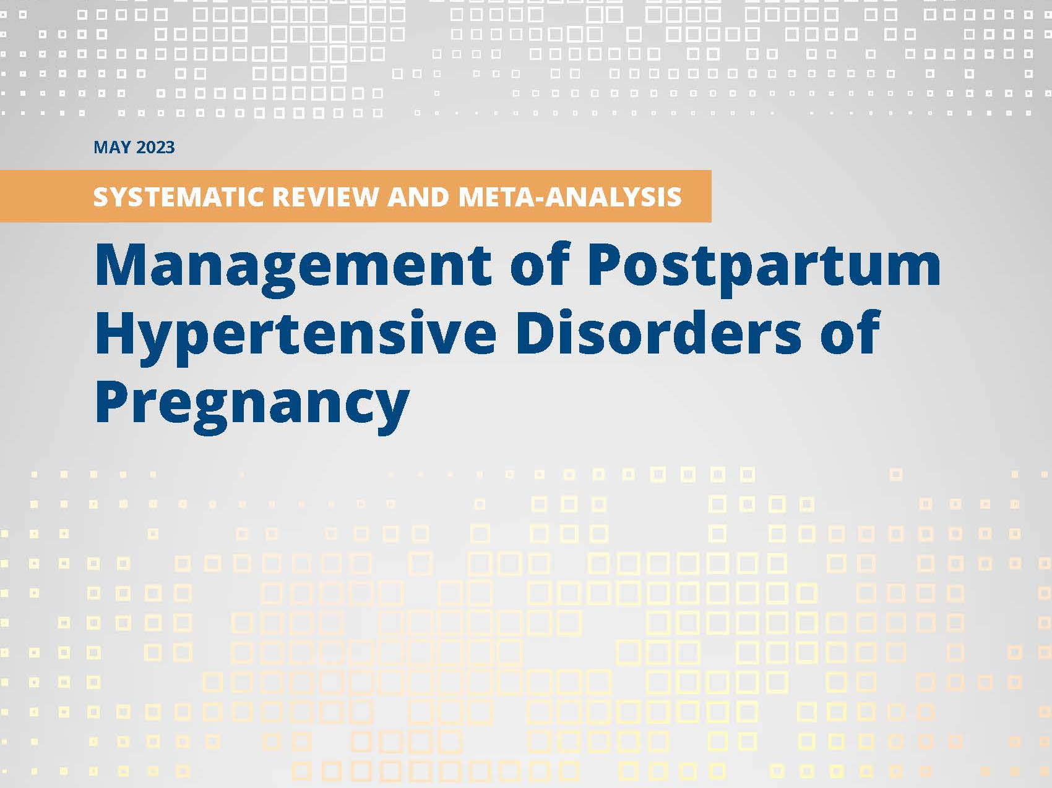
Dale Steele, MD, MS
Task Order Officer: David Niebuhr, M.D., M.S., M.P.H.

Slide 18
Thank You!
Jennie R. Dalton, Program Officer
202.827.7700
jdalton@pcori.org
Research Synthesis:
www.pcori.org/research-results/evidence-synthesis

Slide 19
EPC Maternal Health and Postpartum Care Discussants
Rose Molina, MD., M.P.H.
Assistant Professor of Obstetrics, Gynecology, and Reproductive Biology Harvard Medical School
Megan McReynolds, PMP
Director, Obstetrics and Genetics American College of Obstetricians and Gynecologists (ACOG)

Slide 20
Postpartum Care Up to One Year After Delivery: A Systematic Review and Meta-Analysis
Ian Saldanha, M.B.B.S., M.P.H., Ph.D.
Associate Professor of Epidemiology
Johns Hopkins Bloomberg School of Public Health
Adjunct Associate Professor of Health Services, Policy, and Practice
Brown University School of Public Health
@saldanha_ian

Slide 21
Funding and Relevant Disclosures
Principal Investigator of the project being described today.
No relevant disclosures to report for any team members.
Funding: This report is based on research conducted by the Brown Evidence-based Practice Center (EPC) under contract to the Agency for Healthcare Research and Quality (AHRQ), Rockville, MD. The Patient-Centered Outcomes Research Institute® (PCORI®) funded the report.
Disclaimer: No statement in my presentation should be construed as an official position of AHRQ, the U.S. Department of Health and Human Services (DHHS), or the Patient-Centered Outcomes Research Institute (PCORI).

Slide 22
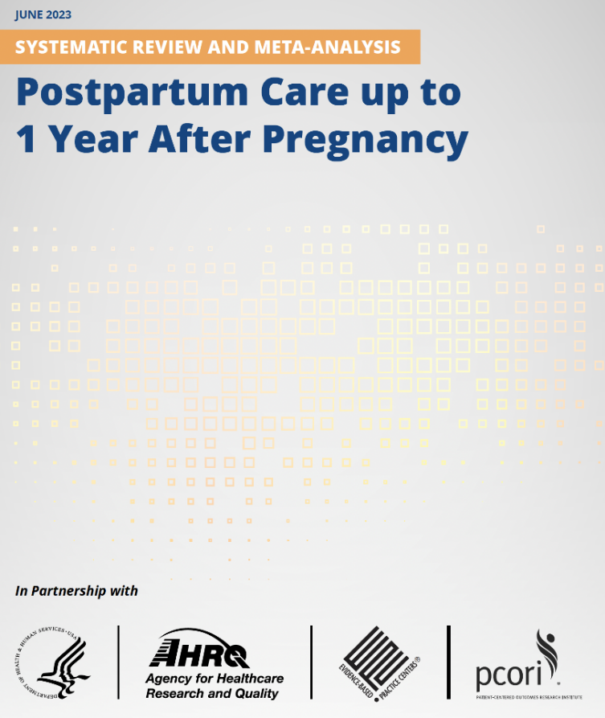
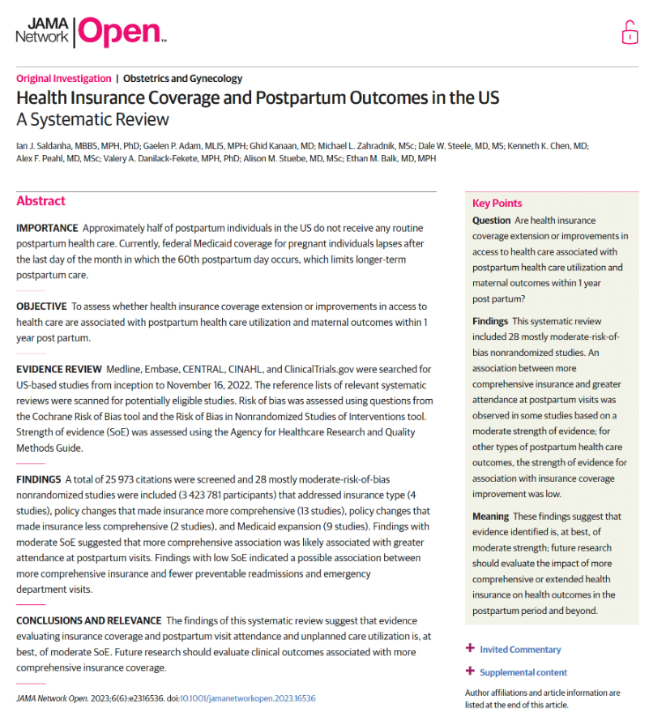
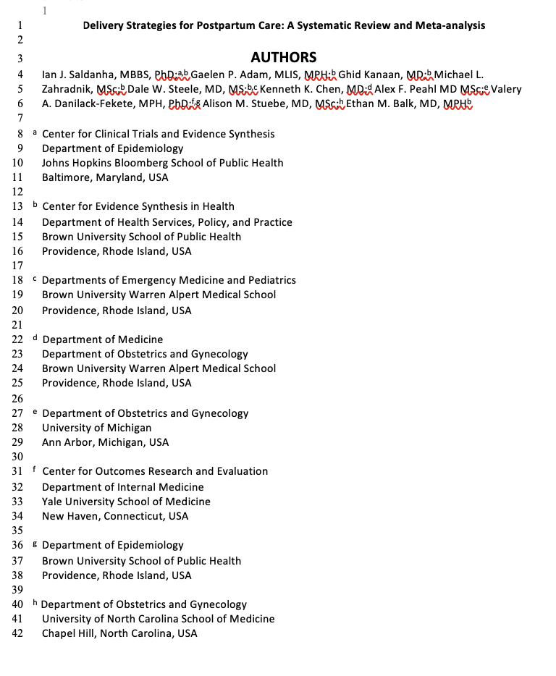
Context
Systematic review and meta-analysis
Designed to inform an upcoming ACOG clinical practice guideline
Saldanha IJ, et al. Postpartum care up to one year after pregnancy: a systematic review and meta-analysis. Agency for Healthcare Research and Quality (Rockville, Maryland, USA). 2023.
Saldanha IJ, et al. Health insurance coverage and postpartum outcomes in the US: A systematic review. JAMA Network Open. 2023; 6(6):e2316536.
Saldanha IJ, et al. Delivery strategies for postpartum care: a systematic review and meta-analysis. Obstetrics & Gynecology. (In press)

Slide 23
Key Question 1
What healthcare delivery strategies affect postpartum healthcare utilization and improve maternal outcomes within 1 year postpartum?

Slide 24
Key Question 1 – Population and Intervention Targets
Population
Postpartum (≤1 year after giving birth), any age
Healthy (general population) or at increased risk of complications due to pregnancy-related conditions (e.g., hypertensive disorders of pregnancy) or due to incident or newly diagnosed conditions postpartum
Intervention Targets
General postpartum care
Specific aspects of postpartum care
Contraceptive care
Breastfeeding care
Screening
Preventive care

Slide 25
Key Question 1 – Delivery Strategies (Comparisons of Interest)
# | Delivery Strategies | Examples
1 | Where healthcare is provided | Hospital, clinic
2 | How healthcare is provided | Dedicated PP visit, part of well-child visit
3 | When healthcare is provided | 2 weeks, 6 weeks
4 | Who provides healthcare/support Predominantly health system-based care Predominantly community-based care | OB/GYN, nurse Doula, peer support
5 | Healthcare coordination and management | Patient navigators
6 | Information technology | Bidirectional texting
7 | Interventions targeted at healthcare providers or systems | Reminders, clinical decision support

Slide 26
Key Question 2
Does extension of health insurance coverage or improvements in access to healthcare affect postpartum healthcare utilization and improve maternal outcomes within 1 year postpartum?

Slide 27
Methods
Standard AHRQ methodology for systematic reviews
Search for published evidence
Screen for eligibility PICODTS (Population, Intervention, Comparator, Outcome Design + Timing + Setting)
Extract data
Evaluate evidence
Risk of Bias of each study
Strength of Evidence (SoE) across studies by considering risk of bias, consistency, precision, directness, other factors – for prioritized outcomes
Insufficient
Low
Moderate
High
Conduct Syntheses of evidence narratively and quantitatively (meta-analyses)

Slide 28
Eligible Study Designs
Both Key Questions
Randomized controlled trials (RCTs) N≥10 per group
Nonrandomized comparative studies (NRCSs) N≥30 per group
(prospective or retrospective)
Key Question 1 – U.S. or Canada only
Key Question 2 – U.S. only

Slide 29
Evidence Identified (92 studies)
Key Question 1: Healthcare Delivery Strategies (64 Studies)
50 RCTs and 14 NRCSs
Risk of Bias: 5 Low, 35 Moderate, 24 High
Key Question 2: Insurance Coverage (28 Studies)
28 NRCSs
Risk of Bias: 0 Low, 19 Moderate, 9 High

Slide 30
KQ1: Healthcare Delivery Strategies (64 Studies)
Delivery Strategy | General Postpartum Care 18 | Contraceptive Care 11 | Breastfeeding Care 29 | Screening/ Preventive Care 6
Where care is provided | 6 | - | 8 | -
How care is provided | 4 | 1 | 2 | -
When care is provided | 3 | 9 | - | -
Who provides care | 8 | 1 | 19 | 2
Care Coordination/ Management | 2 | - | - | 3
Information/ Communication Technology | - | - | 7 | 1
Interventions Targeting Providers | - | - | 2 | 2

Slide 31
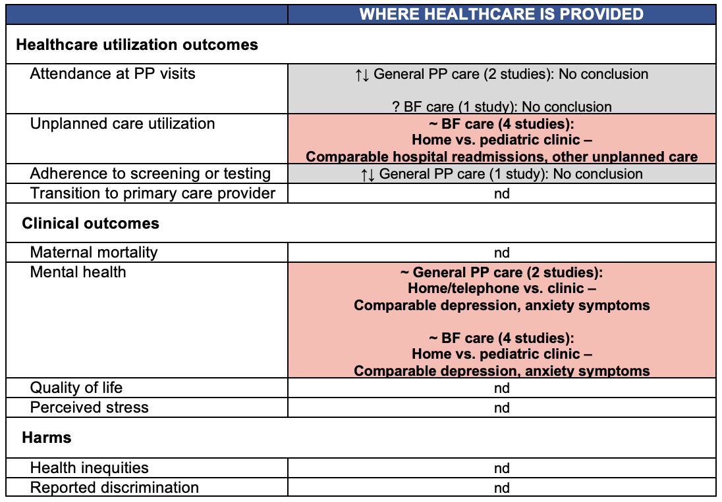
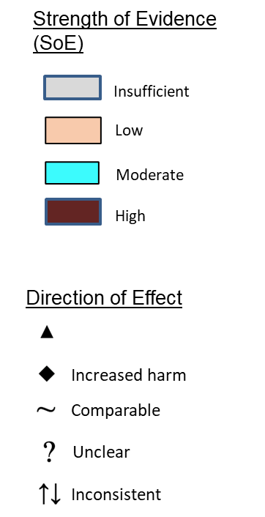
Results – KQ 1: WHERE Healthcare Is Delivered (14 studies)
Abbreviations: BF = breastfeeding, nd = no data, PP = postpartum
Notes:
Larger box

Slide 32
Results – Meta-Analysis Comparing Home Versus Clinic Visits for Breastfeeding Care
Abbreviations: CI = confidence interval, RoB = risk of bias, RR = relative risk
No evidence of difference in hospital readmission by 3 months

Slide 33
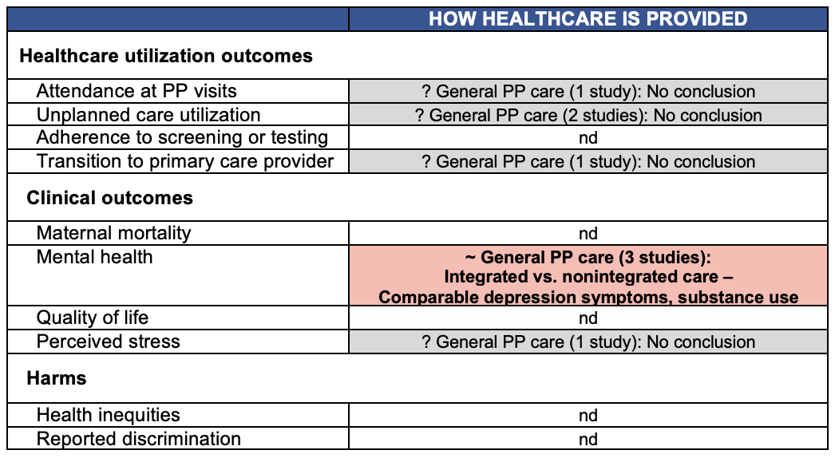
Results – KQ 1: HOW Healthcare Is Provided (7 studies)
Abbreviations: BF = breastfeeding, nd = no data, PP = postpartum
Notes:
Larger box

Slide 34
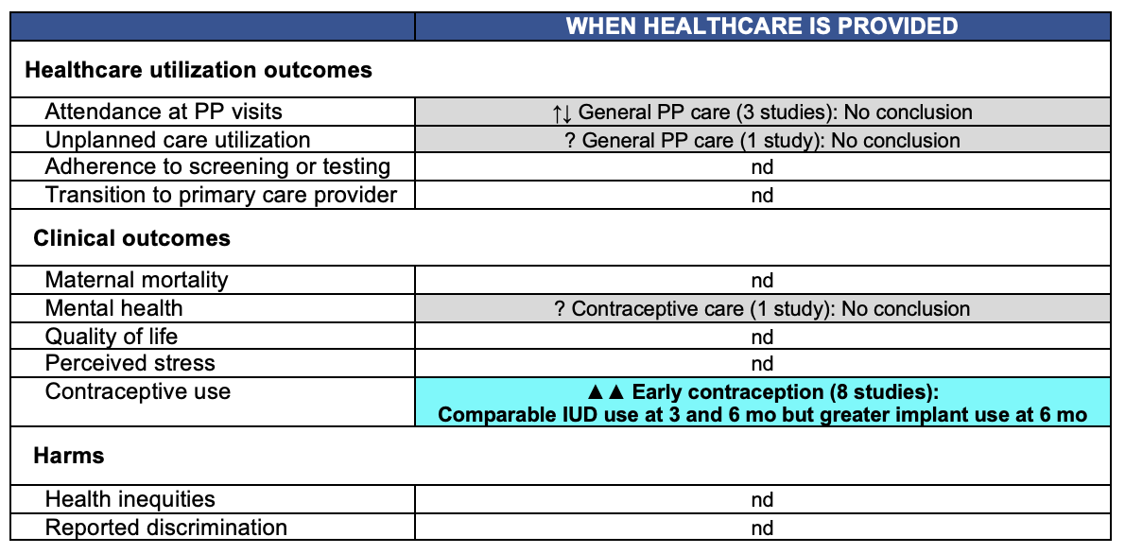
Results – KQ 1: WHEN Healthcare Is Provided (12 studies)
Abbreviations: mo = months, nd = no data, PP = postpartum
Notes:
Larger box

Slide 35
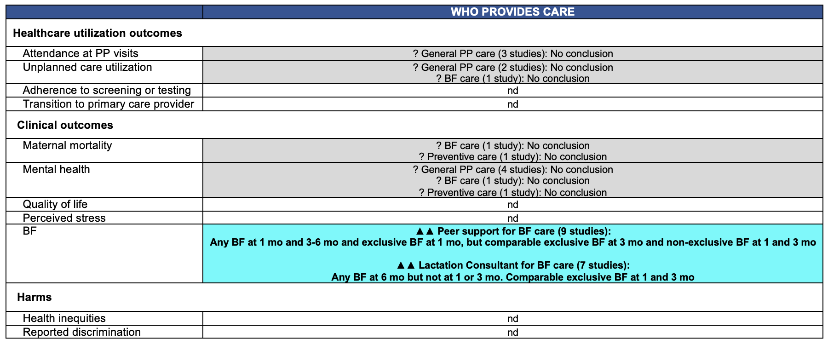
Results – KQ 1: WHO Provides Care (28 studies)
Abbreviations: BF = breastfeeding, nd = no data, PP = postpartum
Notes:
Larger box

Slide 36
Results – KQ 1: Care Coordination/Management (5 studies)
Abbreviations: nd = no data, PP = postpartum
Notes:
Larger box

Slide 37
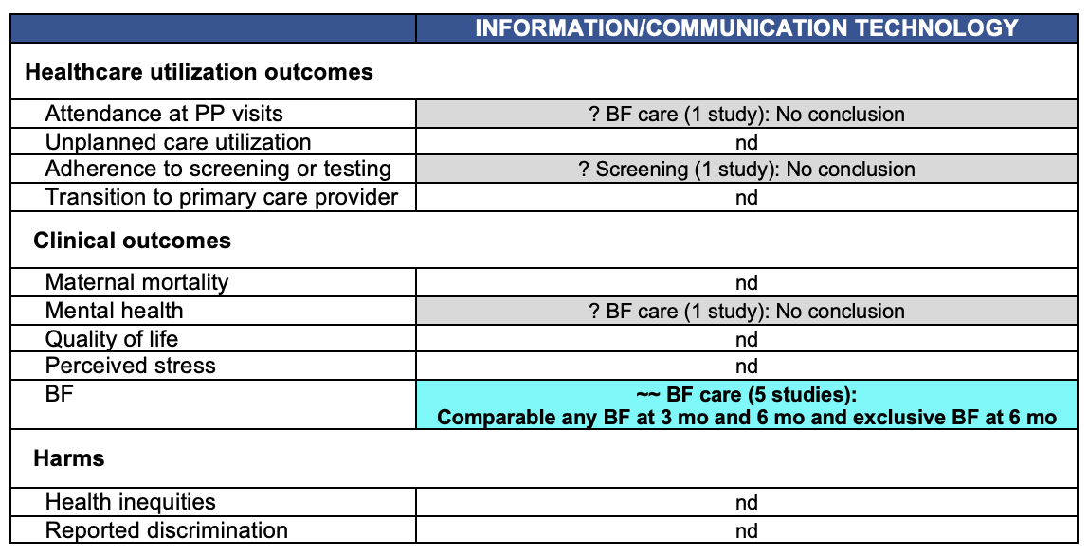
Results – KQ 1: INFORMATION TECHNOLOGY (8 studies)
Strength of Evidence (SoE)
Insufficient
Low
Moderate
High
Direction of Effect
Better outcome
Increased harm
Comparable
Unclear
Inconsistent
Abbreviations: ER = emergency room, nd = no data, PP = postpartum
Notes:
Larger box

Slide 38
Results – KQ 1: Interventions Targeting Healthcare Providers or Systems (4 studies)
No conclusions because no study reported data for our prioritized outcomes
Notes:
Larger box

Slide 39
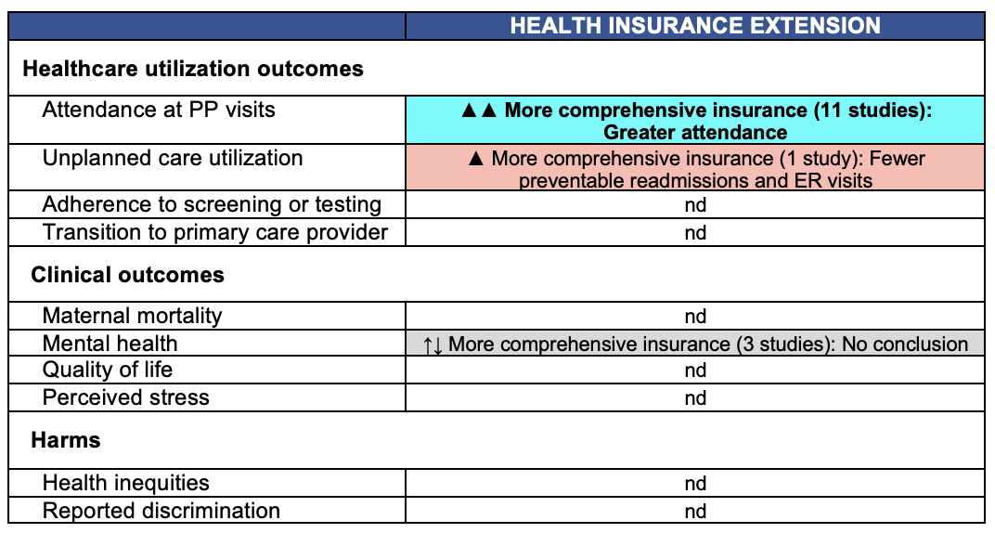
Results – KQ 2: Health Insurance Extension (28 studies)
Strength of Evidence (SoE)
Insufficient
Low
Moderate
High
Direction of Effect
Better outcome
Increased harm
Comparable
Unclear
Inconsistent
Abbreviations: ER = emergency room, nd = no data, PP = postpartum
Notes:
Larger box

Slide 40
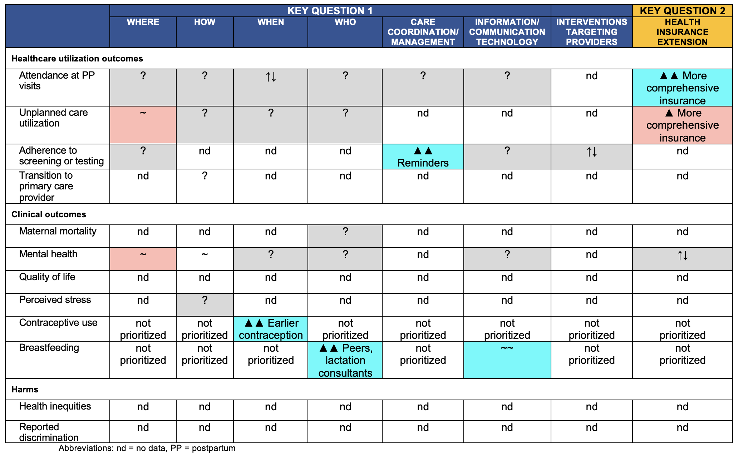
At-a-Glance – Both Key Questions
Strength of Evidence (SoE)
Insufficient
Low
Moderate
High
Direction of Effect
Better clinical outcome
Increased harm
Comparable
Unclear
Inconsistent

Slide 41
Strengths of the Evidence
Applicability to the U.S. decision-making context
Age and racial diversity of populations

Slide 42
Limitations of the Evidence/Recommendations for Research: KQ 1 (Delivery Strategies)
Population and intervention targets:
Limited data on general postpartum care, especially for at-risk populations
Only 28% of studies targeted general postpartum care
72% focused on specific intervention targets (e.g., breastfeeding, contraception)
Delivery strategies:
Sparse evidence for:
Information technology use
Coordination and management of care
Interventions targeting healthcare providers
Limited data on differences by population subgroups (e.g., by race)
Sparse evidence for many outcomes

Slide 43
Limitations of the Evidence/Recommendations for Research: KQ 2 (Health Insurance)
Limited data on differences by population subgroups (e.g., by race)
Sparse evidence for outcomes except postpartum visit attendance and unplanned care utilization
Recent Medicare extension in various states
Excellent opportunity for researchers to evaluate the impact of policy changes on postpartum care utilization and postpartum health, both within and across states.
Do (and to what extent) these policy changes help reduce the racial and other disparities in postpartum outcomes in the US?

Slide 44
Acknowledgments
Evidence-based Practice Center Team
Brown U
Ian Saldanha, M.B.B.S., M.P.H., Ph.D.
Ethan Balk, M.D., M.P.H.
Gaelen Adam, M.L.I.S., M.P.H.
Ghid Kanaan, M.D.
Michael Zahradnik, M.S., M.P.H.
Kenneth Chen, M.D.
UNC Chapel Hill
Alison Stuebe, M.D.
U Michigan
Alex Friedman Peahl, M.D., M.Sc.
Yale
Valery Danilack, Ph.D.
AHRQ Task Order Officer
Jill Huppert, M.D., M.P.H.
Patient-Centered Outcomes Research Institute (PCORI)
Jennie Dalton
Paula Eguino Medina
American College of Obstetricians and Gynecologists (ACOG)
Elizabeth York
Megan McReynolds
Margaret Villalonga (no longer at ACOG)
Key Informants
Technical Expert Panel Members
EPC Program Associate Editor
Peer Reviewers
named and acknowledged in
Final Report

Slide 45
Thank You!
Ian Saldanha, M.B.B.S., M.P.H., Ph.D.
isaldan1@jhu.edu
@saldanha_ian

Slide 46
Initial Reactions
Rose Molina, M.D., M.P.H.
Assistant Professor of Obstetrics, Gynecology, and Reproductive Biology Harvard Medical School
Megan McReynolds, PMP
Director, Obstetrics and Genetics American College of Obstetricians and Gynecologists (ACOG)

Slide 47
Management of Postpartum Hypertensive Disorders of Pregnancy
Dale Steele, M.D., M.S.
Professor of Emergency Medicine and Pediatrics
Adjunct Professor of Health Services, Policy, and Practice
Brown University Evidence-based Practice Center (EPC)
Center for
Evidence Synthesis in Health

Slide 48
Funding and Potential Conflicts of Interest
There are no relevant conflicts of interest for any team members
Funding: This report is based on research conducted by the Brown Evidence-based Practice Center (EPC) under contract to the Agency for Healthcare Research and Quality (AHRQ), Rockville, MD. The Patient-Centered Outcomes Research Institute® (PCORI®) funded the report.
Disclaimer: The findings and conclusions presented are those of the authors, who are responsible for its contents; the findings and conclusions do not necessarily represent the views of AHRQ or PCORI. Therefore, no statement in this report should be construed as an official position of PCORI, AHRQ, or the U.S. Department of Health and Human Services.

Slide 49
Acknowledgments
Brown EPC team
Brown U
Dale Steele, M.D., M.S.
Ethan Balk, M.D., M.P.H.
Ian Saldanha, M.B.B.S., M.P.H., Ph.D.
Gaelen Adam, M.L.I.S., M.P.H.
Ghid Kanaan, M.D.
Michael Zahradnik, M.S., B.D.S., M.P.H.
Kenneth Chen, M.D.
UNC Chapel Hill
Alison Stuebe, M.D.
U Michigan
Alex Friedman Peahl, M.D., M.Sc.
Yale
Valery Danilack, P.h.D.
AHRQ Task Order Officer
David W. Niebuhr, M.D., M.S., M.P.H.
Anjali Jain, M.D.
PCORI
Jennie Dalton
Paula Eguino Medina
ACOG
Elizabeth York
Megan McReynolds
Key Informants
Technical Expert Panel Members
EPC Program Associate Editor
Peer Reviewers
Public Commenters
Named and acknowledged in Report

Slide 50
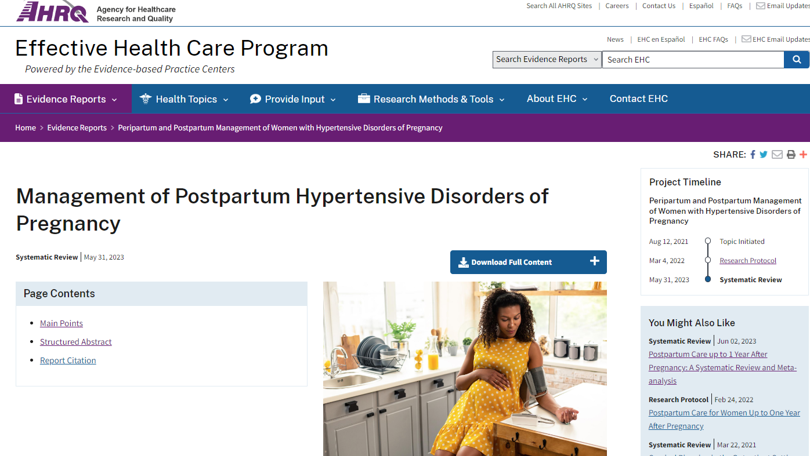
The AHRQ Effective Healthcare Website

Slide 51
Context
Systematic review with 3 Key Questions
Designed to inform an ACOG clinical practice guideline
Today’s focus on Key Question 1: Postpartum Home Blood Pressure Monitoring
Published ahead-of-print 6/13/2023

Slide 52
Key Questions
Key Question 1
What are the effectiveness, comparative effectiveness, and harms of home blood pressure monitoring/telemonitoring in postpartum individuals?
Key Question 2
What are the effectiveness, comparative effectiveness, and harms of pharmacological treatments for hypertensive disorders of pregnancy in postpartum individuals?
Key Question 3
What are the comparative effectiveness and harms of alternative magnesium sulfate (MgSO₄) treatment regimens to treat preeclampsia with severe features during the peripartum period?
3a. Are there harms associated with the concomitant use of particular antihypertensive medications during treatment with MgSO₄?

Slide 53
Contextual Question (in discussion)
How are race, ethnicity, and social determinants of health related to disparities in incidence and detection of HDP, as well as access to care, management, follow up care, and clinical outcomes in individuals with postpartum hypertensive disorders of pregnancy?

Slide 54
Eligible Study Designs
Randomized controlled trials (RCTs)
N ≥10 per group
Nonrandomized comparative studies (NRCSs)
Prospective or retrospective that use statistical techniques to reduce bias due to confounding
Key Question 1 only: Single group studies (N ≥ 50) individuals offered home blood pressure monitoring

Slide 55
Key Question 1: What are the effectiveness, comparative effectiveness and harms of HBPM?
Effectiveness: 2 RCTs, 1 NRCS
HBPM via smartphone app/text vs. usual care (RCT, n=91)
HBPM via text vs. usual care (RCT, n=206)
HBPM via text vs. usual care (NRCS, n=428)
Comparative Effectiveness: 1 RCT, 1 NRCS
HBPM: tablet vs. paper log (RCT, n=213, clinicaltrials.gov only)
All discharged with BP device: audio-only telehealth vs. paper log (NRCS, n=473)
Single arm studies (7 studies, all participants offered HBPM intervention)
Feasibility (4 studies, n=222),
Implementation (3 prospective studies, n=941)
Quality improvement (1 retrospective study, n=1192)

Slide 56
Key Question 1 Conclusions: Home blood pressure monitoring (HBPM) of postpartum individuals with a prior HDP diagnosis
HBPM probably increases submission of BP measurements during recommended time intervals (Moderate SoE)
HBPM may increase the number of BP measurements obtained overall (Low SoE)
HBPM probably compensates for racial disparities in office based follow up (Moderate SoE)
In one study, 87% of patients were satisfied with using HBPM (Low SoE)
HBPM may not affect likelihood of initiation of BP treatment (Low SoE, no evidence of difference)
HBPM may reduce unplanned HTN-related hospital readmissions (Low SoE)

Slide 57
Key Question 1 (HBPM): Strengths and Limitations
Strengths
The Heart Safe Motherhood program has been evaluated in both a randomized clinical trial and in single- and multi-center cohorts
https://www.pennmedicine.org/for-patients-and-visitors/find-a-program-or-service/obstetrics/maternity-care/heart-safe-motherhood

Slide 58
Key Question 1 (HBPM): Strengths and Limitations
Strengths
Other HBPM programs have been evaluated in a NRCS and in large cohorts
A single comparative effectiveness trial (in clinicaltrials.gov only) supports use of remote communication of BP measurements versus home BP cuff with a paper log
Limitations
Small sample size, not powered to detect differences in patient outcomes
Enrolled participants with an antepartum HDP diagnosis, primarily in urban academic medical centers
The relatively low enrollment rates in some studies may reflect implementation challenges

Slide 59
Conclusions
HBPM probably improves ascertainment of BP, allowing early recognition of HTN in postpartum patients, and may compensate for racial disparities in office-based follow up.
Oral furosemide may shorten the duration of postpartum HTN in individuals with preeclampsia or gestational hypertension.
Patients with postpartum HTN discharged on labetalol may have higher rates of unplanned readmission than those discharged on nifedipine
Large pragmatic trials, augmented by analysis of real-world data, are needed to identify MgSO₄ regimen(s) with lowest effective dose to minimize unpleasant side effects and toxicity, given for the shortest effective duration

Slide 60
Discussion: Necessary, But Not Sufficient
Improved ascertainment and monitoring of postpartum BP is necessary to identify hypertension but is by no means sufficient to reduce maternal morbidity and mortality, unless combined with ready access to a health care professional for medication initiation and titration, and further urgent or emergent evaluation and treatment if needed.

Slide 61
Discussion: Potentially Complex Relationship With Healthcare Utilization…
Early recognition of hypertension, combined with effective communication and initiation of antihypertensive treatment has the potential to decrease the need for rehospitalization. However, the effects on health care utilization may be complex because home BP monitoring will prompt referral of some individuals for urgent or emergent evaluation, which may result in an increase in emergency department visits and rehospitalization.

Slide 62
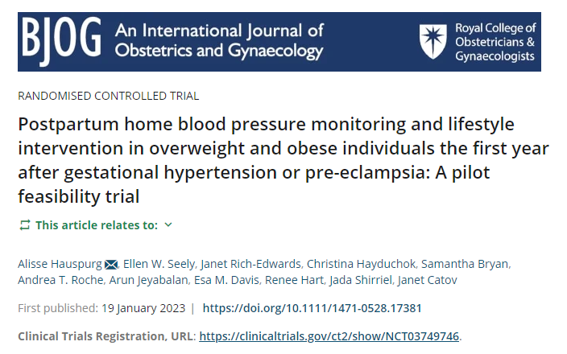
Several ongoing studies may change our conclusions

Slide 63
Questions?
Dale Steele, M.D., M.S.
Dale_Steele@brown.edu

Slide 64
Initial Reactions
Rose Molina, M.D., M.P.H.
Assistant Professor of Obstetrics, Gynecology, and Reproductive Biology Harvard Medical School
Megan McReynolds, PMP
Director, Obstetrics and Genetics American College of Obstetricians and Gynecologists (ACOG)

Slide 65
General Moderated Discussion and Q&A

Slide 66
Implications for Policy, Equity, and Health Systems
Rose Molina, M.D., M.P.H.
Assistant Professor of Obstetrics, Gynecology, and Reproductive Biology Harvard Medical School
Megan McReynolds, PMP
Director, Obstetrics and Genetics American College of Obstetricians and Gynecologists (ACOG)

Slide 67
Thank you for you joining us! Please be on the look out for an announcement of the next EPC Grand Rounds date and theme.
For more information on the EPC Program and reports, please scan or take a photo of the following QR code.

